Slide 1


Scottish Approach to Change
This is a set of slides for you to draw from if talking about Scottish Approach to Change
Leading quality health and care for Scotland

Slide 2
What is change?
Effective change - needs a robust approach
A clear and agreed ‘why’
Involves people in change
Creates a clear plan
Learns and adapts throughout
Invests time, people, energy and funding
Change includes
Process improvements
New service models
Pathway redesign
Whole system transformation
Culture change
Notes:
Change is the transition of an organisation, pathway, service, or process from a current state (how things are done today), through a transition state (the change), into a future state (a new way of operating).
Change can be a positive thing which leads to improvements in the way things are done and the outcomes that are achieved for the people who need, use, deliver, and support services. Change can reveal new opportunities and lead to innovative solutions.
Change can be small in scale, or it might be large scale organisation-wide change. In health and social care change might look like:
Process improvements – such as changing the way waiting lists are managed
New service models – such as moving to a community-led model of care
Pathway redesign – such as redesigning urgent care pathways
Whole system transformation – such as implementing value-based health and care across an organisation
Culture change – such as shifting towards an enabling culture focused on Getting It Right For Everyone
Delivering effective change
To deliver effective change it is essential that the process of change is underpinned by a robust approach.
A robust approach to change increases the chance that change will be successful by:
Ensuring there is a clear “why” that is aligned to the organisation’s vision and purpose and is effectively communicated to the people affected by the change
Involving people in the planning, design, and delivery of the change to increase support and buy-in
Ensuring there is a clear plan in place to implement, embed and sustain the change
Ensuring that processes are in place to learn and adapt throughout the change
It is critical that change is sufficiently resourced (time, people, and funding) – effective change requires investment, however there are high returns when change is done well.

Slide 3

What drives our need for change?
The Scottish Approach to Change is recognised as an integral part of delivering the renewal agenda by providing a clear and coherent method for change.
Notes:
Health and social care organisations are facing an unprecedented volume and pace of change arising from NHS renewal, service challenges, and wider reform. There is a need to respond to three key drivers of change:
Policy direction – the Scottish Government has a clear vision for the future of health and social care in Scotland. This vision prioritises prevention, care designed around people, community delivery, population planning, and digital and technological innovation. This vision is set out in the following documents:
Health and Social Care Renewal Framework
Scotland's Population Health Framework
Scotland’s Public Service Reform Strategy
Resource pressures – health and social care in Scotland is facing ongoing financial constraints and workforce shortages.
Rising demand and need – increasing complexity of care and multi-morbidity means there is an additional pressure to move away from single condition care.
The Scottish Approach to Change is recognised as an integral part of delivering the renewal agenda by providing a clear and coherent method for change.

Slide 4
Building the Scottish Approach to Change: principles
Aims
Maximise the benefits of different change methods
Provide continuity of approach:
  Applicable to any scale and type of change
  Applicable to different settings
  Framework for managing quality and change
Be accessible and understandable by everyone
Be able to drive meaningful change
Notes:
The Scottish Approach to Change has been designed to create a clear pathway to support everyone to do change well. It aims to:
Bring together siloed change methods into a single approach, showing how they can be used together. These include quality improvement, service design, engagement practice, strategic planning and human learning systems.
Be practical – it translate theory into a practical, coherent approach.
Be applicable to any scale of change (from small tests of change to system level transformation) and type of change (e.g. patient safety, digital innovation, etc.).
Be applicable to different health and social care settings (e.g. acute hospitals, community care organisations, etc.).
Be accessible and understandable by everyone working in health and social care, whether or not they have expertise in change methodologies.
Create a universal language and a common approach to foster shared understanding of what is needed to achieve high quality change.

Slide 5
Building the Scottish Approach to Change: evidence base
Diverse improvement priorities
Adaptability, spread and sustainability
Capacity, capability and culture
Notes:
We know from our evidence base that how you do change matters.
Diverse improvement priorities
The evidence is clear that when people don't have rigour and structure to how they do change this results in multiple improvement priorities. This means that nothing really gets get changed. People can get lost and change fatigue becomes incredibly high.
Adaptability, spread and sustainability
The common challenge we see in lots of improvement work is that people see a good thing that's happening over there and want to copy it.
The idea that you can just see a good thing and have it everywhere presents us with real challenges. There is a need to adapt to local needs and to understand what it is you're trying to spread and why. There is a need to build change in within the local system to create sustainability, so that the service will work and be able to be funded as it goes forward.
Capacity, capability and culture
There is a need for institutional capacity, capability and culture for change. We need to support people to do change well and have access to the right skills and tools.
We need to support a culture that is person-centred, thoughtful, and that embodies collaborative leadership while taking a rigorous approach.

Slide 6
Building the Scottish Approach to Change: approach
We have built the Scottish Approach to Change through:
Being curious
Learning and adapting as we go
Involving and engaging a wide range of stakeholders
Drawing on real world experience (including from our pathfinder sites)
Collaboration with partners
This has been built with the same ethos we hope people will use for doing change

Slide 7
Scottish Approach to Change
Notes:
What and why
Health and social care organisations are facing an unprecedented volume and pace of change arising from NHS renewal, service challenges, and wider reform: many people feel overwhelmed. The number of methods and tools used for change is huge, and there is significant variation in the adoption of different change methods between health and social care organisations.
The Scottish Approach to Change helps make sense of this chaos by:
- creating a clear pathway to support everyone to do change well
- bringing together siloed change methods into a single approach, showing how they can be used together – these include quality improvement, service design, engagement practice, strategic planning, and human learning systems
- translating theory into a practical, coherent, decision-support tool
creating a universal language and a common approach to foster shared understanding of what is needed to achieve high quality change across professions and organisations.
The Scottish Approach to Change can be used as:
- a practical approach to manage discreet change projects at any level
- a framework for managing quality and change at an organisational level based on aligning a vision, whole-system thinking, empowering staff, and delivering high-quality equitable services.
The Scottish Approach to Change is made up of three parts - steps, enablers and quality management system. It is crucial they all work together and are applied consistently.
The five enablers of quality and change create the conditions that support successful and sustainable improvement. They do this by aligning people, processes, and leadership around a shared purpose.
The eight steps of change provide a practical, structured approach to achieving successful change.
Background
Scottish Government commissioned Healthcare Improvement Scotland (HIS) to develop the Scottish Approach to Change in 2024 to develop a clear and coherent methodology to underpin NHS Renewal.
It is aligned with the Scottish Government’s Health and Social Care Service Renewal Framework, published in June 2025. The Scottish Approach to Change was approved as the delivery mechanism for change by NHS board chief executives and Health and Social Care Partnership (HSCP) chief officers in October 2025.
This work contributes to HIS’s strategic function of providing improvement and redesign support for health and care, and the strategic priority of delivering support to accelerate the delivery of sustainable improvements in healthcare.
Phase 1 defined a high-level framework for change, consolidating what is known already. Phase 2 formally launched the framework and established a more detail approach to change. Phase 3 is focussing on embedding it across Scotland and its continual development through practical tools and resources to support its use.
Introducing the Scottish Approach to Change
There is often an implementation gap between policy ambitions and reality. Evidence shows that a significant contributing factor to this is that change is not always done well in health and social care. The Scottish Government commissioned HIS to develop a Scottish Approach to change to underpin delivery of health and social care renewal and reform.
The Scottish Approach to Change aims to:
Create a clear pathway to support everyone to do change well
It does this by:
Bringing together siloed change methods into a single approach, showing how they can be used together
Translating theory into a practical, coherent tool
Creating a universal language for change
The Scottish Approach to Change can be used to:
Manage discreet change projects
Provide an organisational framework for managing quality and change
The Scottish Approach to Change includes an approach to quality management, five enablers, and eight steps. Together, they create strong support for successful and lasting change.

Slide 8
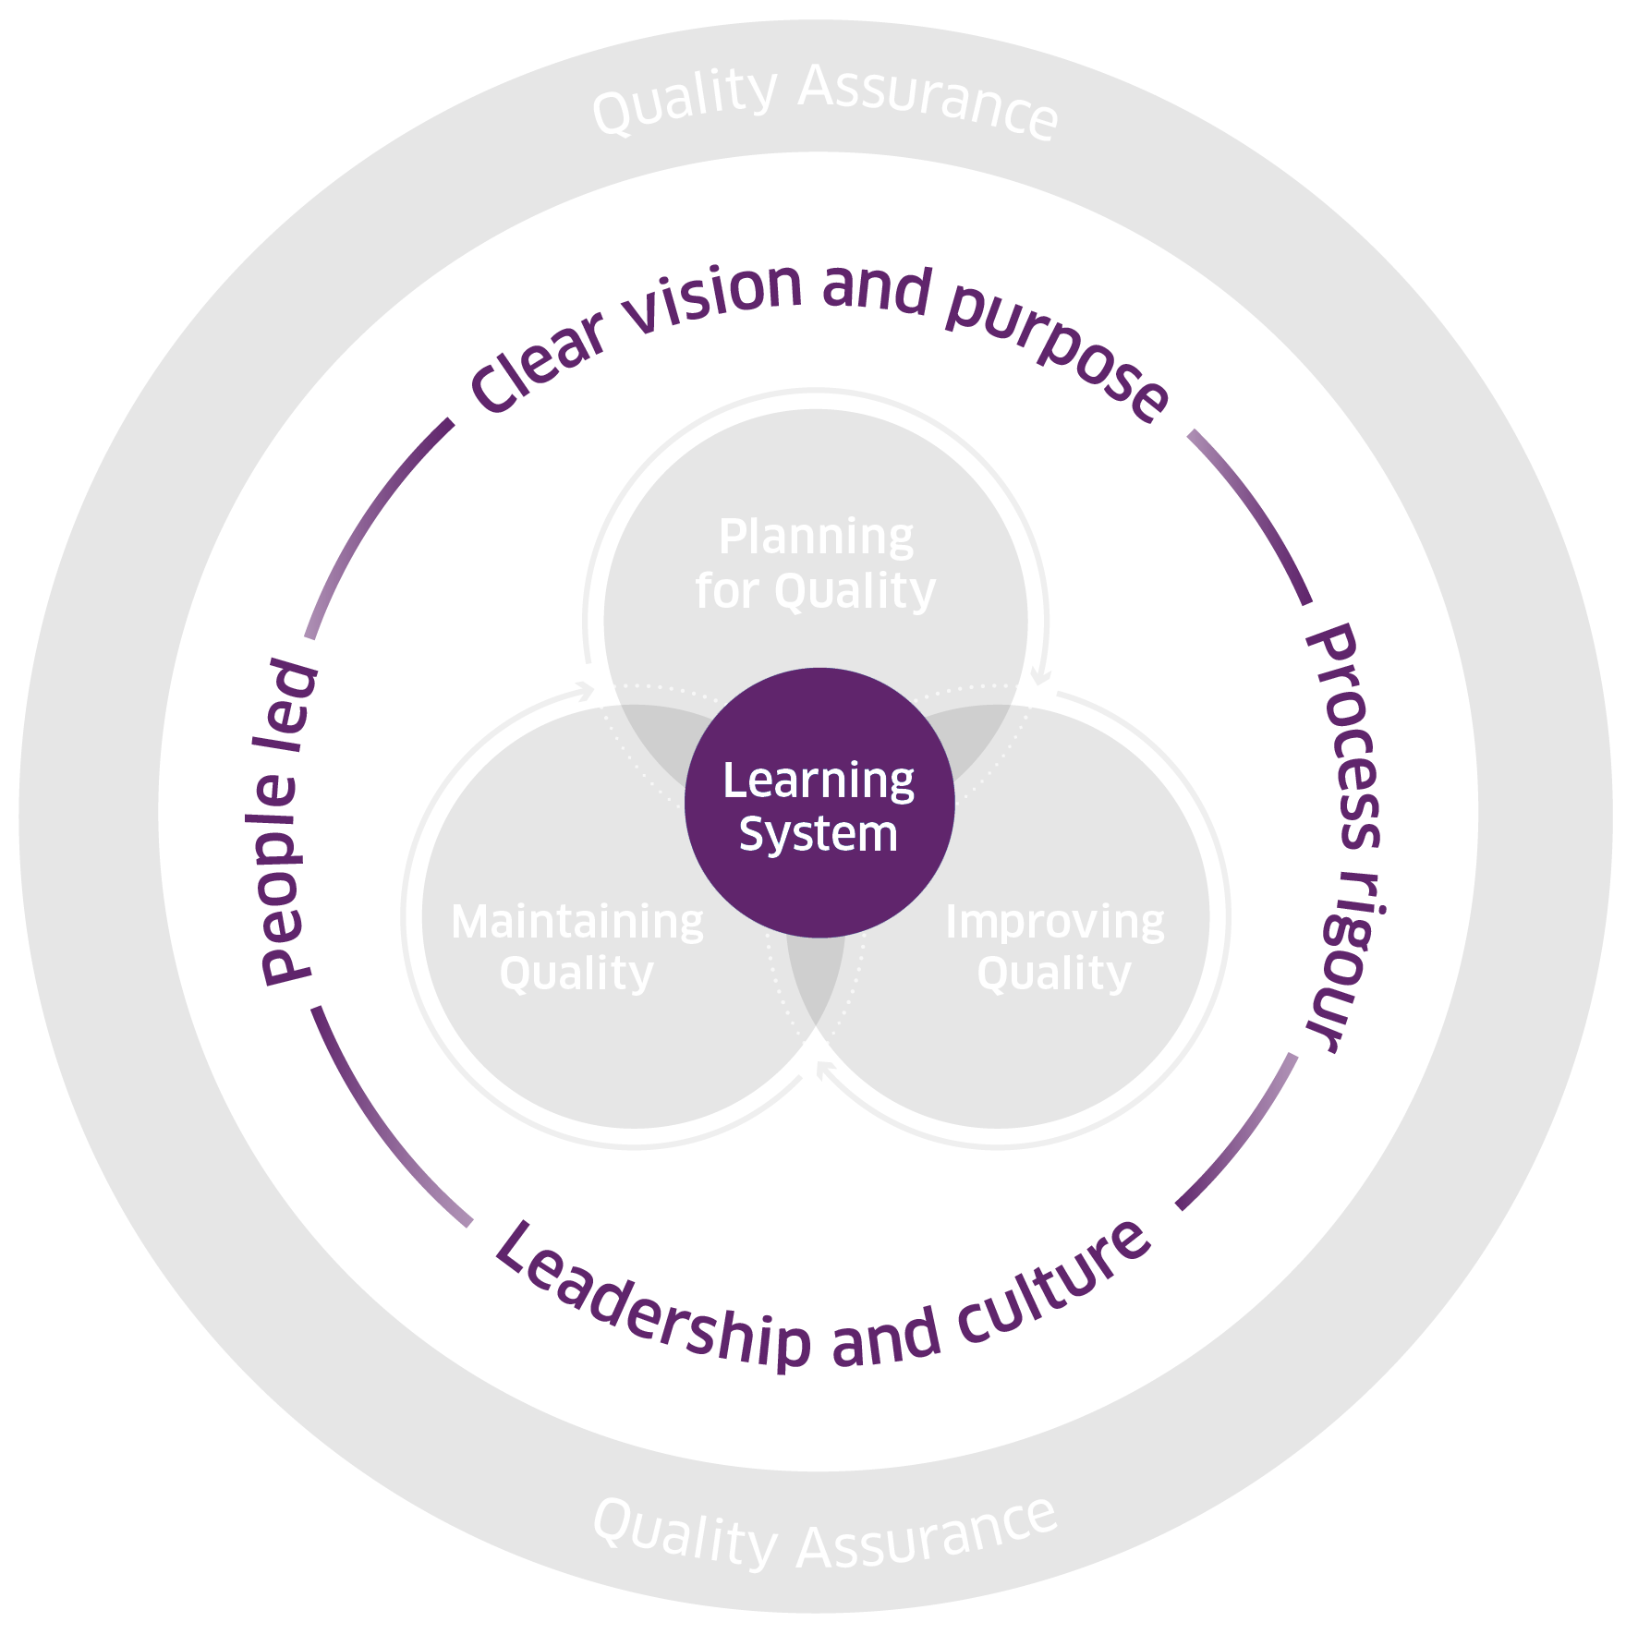
Scottish Approach to Change: enablers
Clear vision and purpose – providing direction, motivation, and alignment
Leadership and culture – setting a vision, and inspiring and empowering others
People led – meaningfully engaging and involving people to help meet their needs
Process rigour – going through a structured process to ensure high-quality outcomes
Learning system – sharing learning and knowledge to support improvement and better outcomes
© Healthcare Improvement Scotland. Published: 2025
Notes:
The five enablers of quality and change create the conditions that support successful and sustainable improvement. They do this by aligning people, processes, and leadership around a shared purpose. These must all be in place for successful change.
The enablers are:
Define a clear vision and purpose that drives your change. It unites us and builds momentum behind a single direction, and is tangible and actionable, it doesn’t shy away from hard choices.
Outline a rigorous approach to how you understand change. It adds clarity to we are doing, when and why - it brings calm to the noise of change, and helps increase our confidence in decision making, supporting momentum in uncertainty and complexity.
Create the conditions for change to thrive through setting the right culture and leadership. It sets the vision, empowers others and unblocks barriers to change, and sees leaders stepping into change, playing an active role.
Take a people-led approach by inviting people to design and deliver change together. It values meaningful engagement as vital, not an additional ‘thing to do’, people articulating their own needs and supports them to do so meaningfully, and the needs of people over the needs of the system - services belong to people.
Embed a learning culture to support your change programme sustainably. It is a superpower – it unlocks knowledge, solutions, energy, momentum and brilliance, and requires commitment, it challenges our engrained values and behaviours, and needs continued practice.
Evidence shows that without these enablers, change can:
Face more systemic challenges and organisational barriers
Struggle to gain support and make progress
Be more challenging to sustain over time
Successful change relies on having all five enablers in place.

Slide 9
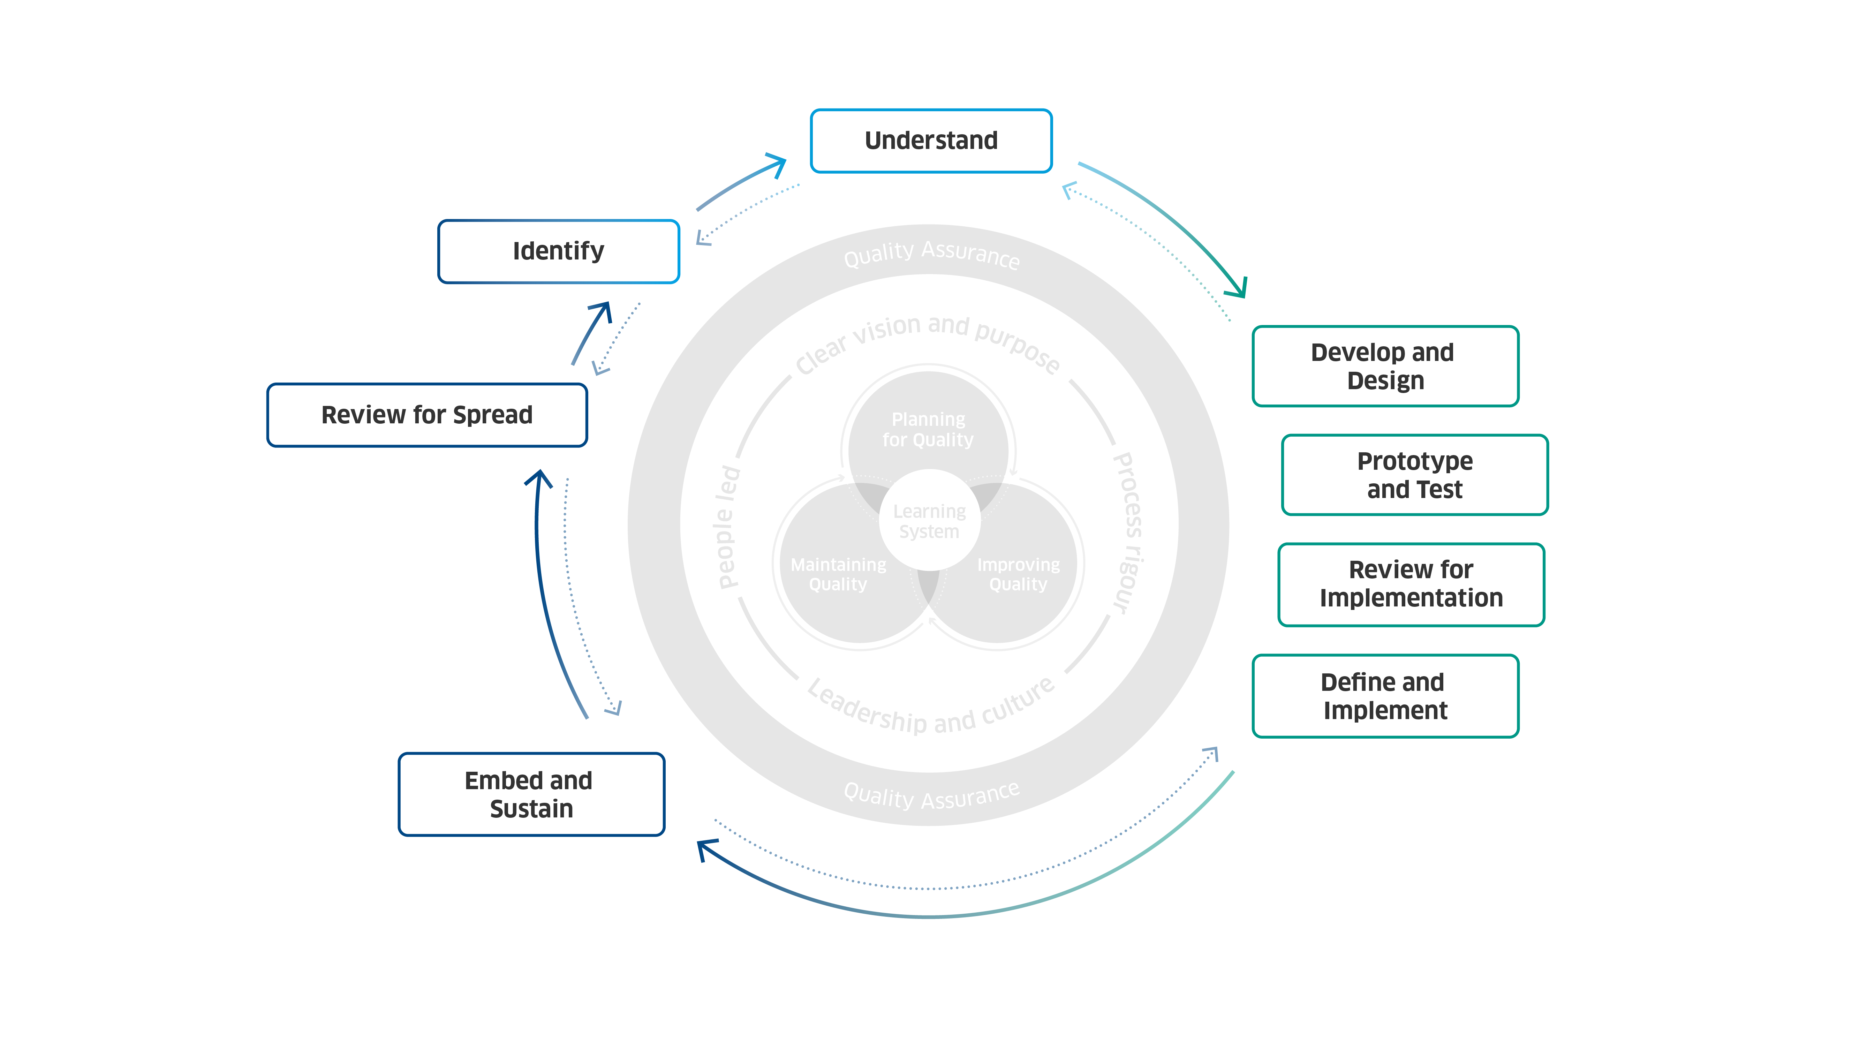
Scottish Approach to Change: steps
Notes:
The eight steps of change provide a practical, structured approach to achieving successful change. These are:
Identify: Identifying the need for change can come from many sources. You can learn from staff, service users, new technologies, or updates in policy and strategy.
Understand: Understanding the challenge or opportunity you have found is key. It helps you choose the best option for change and guides your approach to making it happen.
Develop and design: Developing and designing your options and collaborating with others to develop better solutions.
Prototype and test: Prototyping and testing what works and what does not work, allowing you to continue improving and refining your change.
Review for implementation: Reviewing for implementation to reflect on where you are and deciding how you want to continue.
Define and implement: Defining and implementing how you will support teams in enabling that change as part of business as usual.
Embed and sustain: Embedding and sustaining as part of routine and culture.

Slide 10
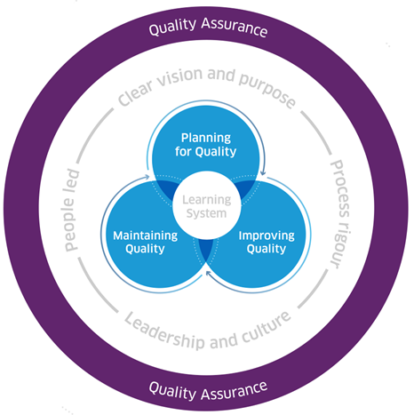
Scottish Approach to Change: Quality Management
Notes:
Quality management supports delivery of high-quality care in health and social care organisations.
It is essential to both day-to-day operations and the delivery of effective change.
Quality management is a coordinated and interconnected approach to:
Planning for quality – proactive planning and prioritisation of services and processes
Improving quality – a systematic and coordinated approach to making services or processes better
Maintaining quality – routine monitoring to assess and maintain performance
Quality assurance – internal and external processes to ensure services are operating effectively and providing quality care

Slide 11




Available support
Digital resource provides detailed guidance, tools, resources, and case studies to help you use the Scottish Approach to Change.
Scottish Approach to Change learning community to access our learning events (including webinars, reflective practice, and project surgery sessions) and to receive information, advice, and peer support on using the Scottish Approach to Change.
Provision of direct tailored support for NHS boards and HSCPs who are looking to embed the Scottish Approach to Change – local areas can express an interest in receiving support by contacting his.satc@nhs.scot.
Education and training offers are being considered to support the Scottish Approach to Change - until then support can be found on the various methods included in the Scottish Approach to Change on the education and training page.

