Slide 1

Scottish Approach to Change
Slides that can be used
Last updated 24 April 2026

Slide 2
Scottish Approach to Change

Slide 3
The Scottish Approach to Change

Slide 4
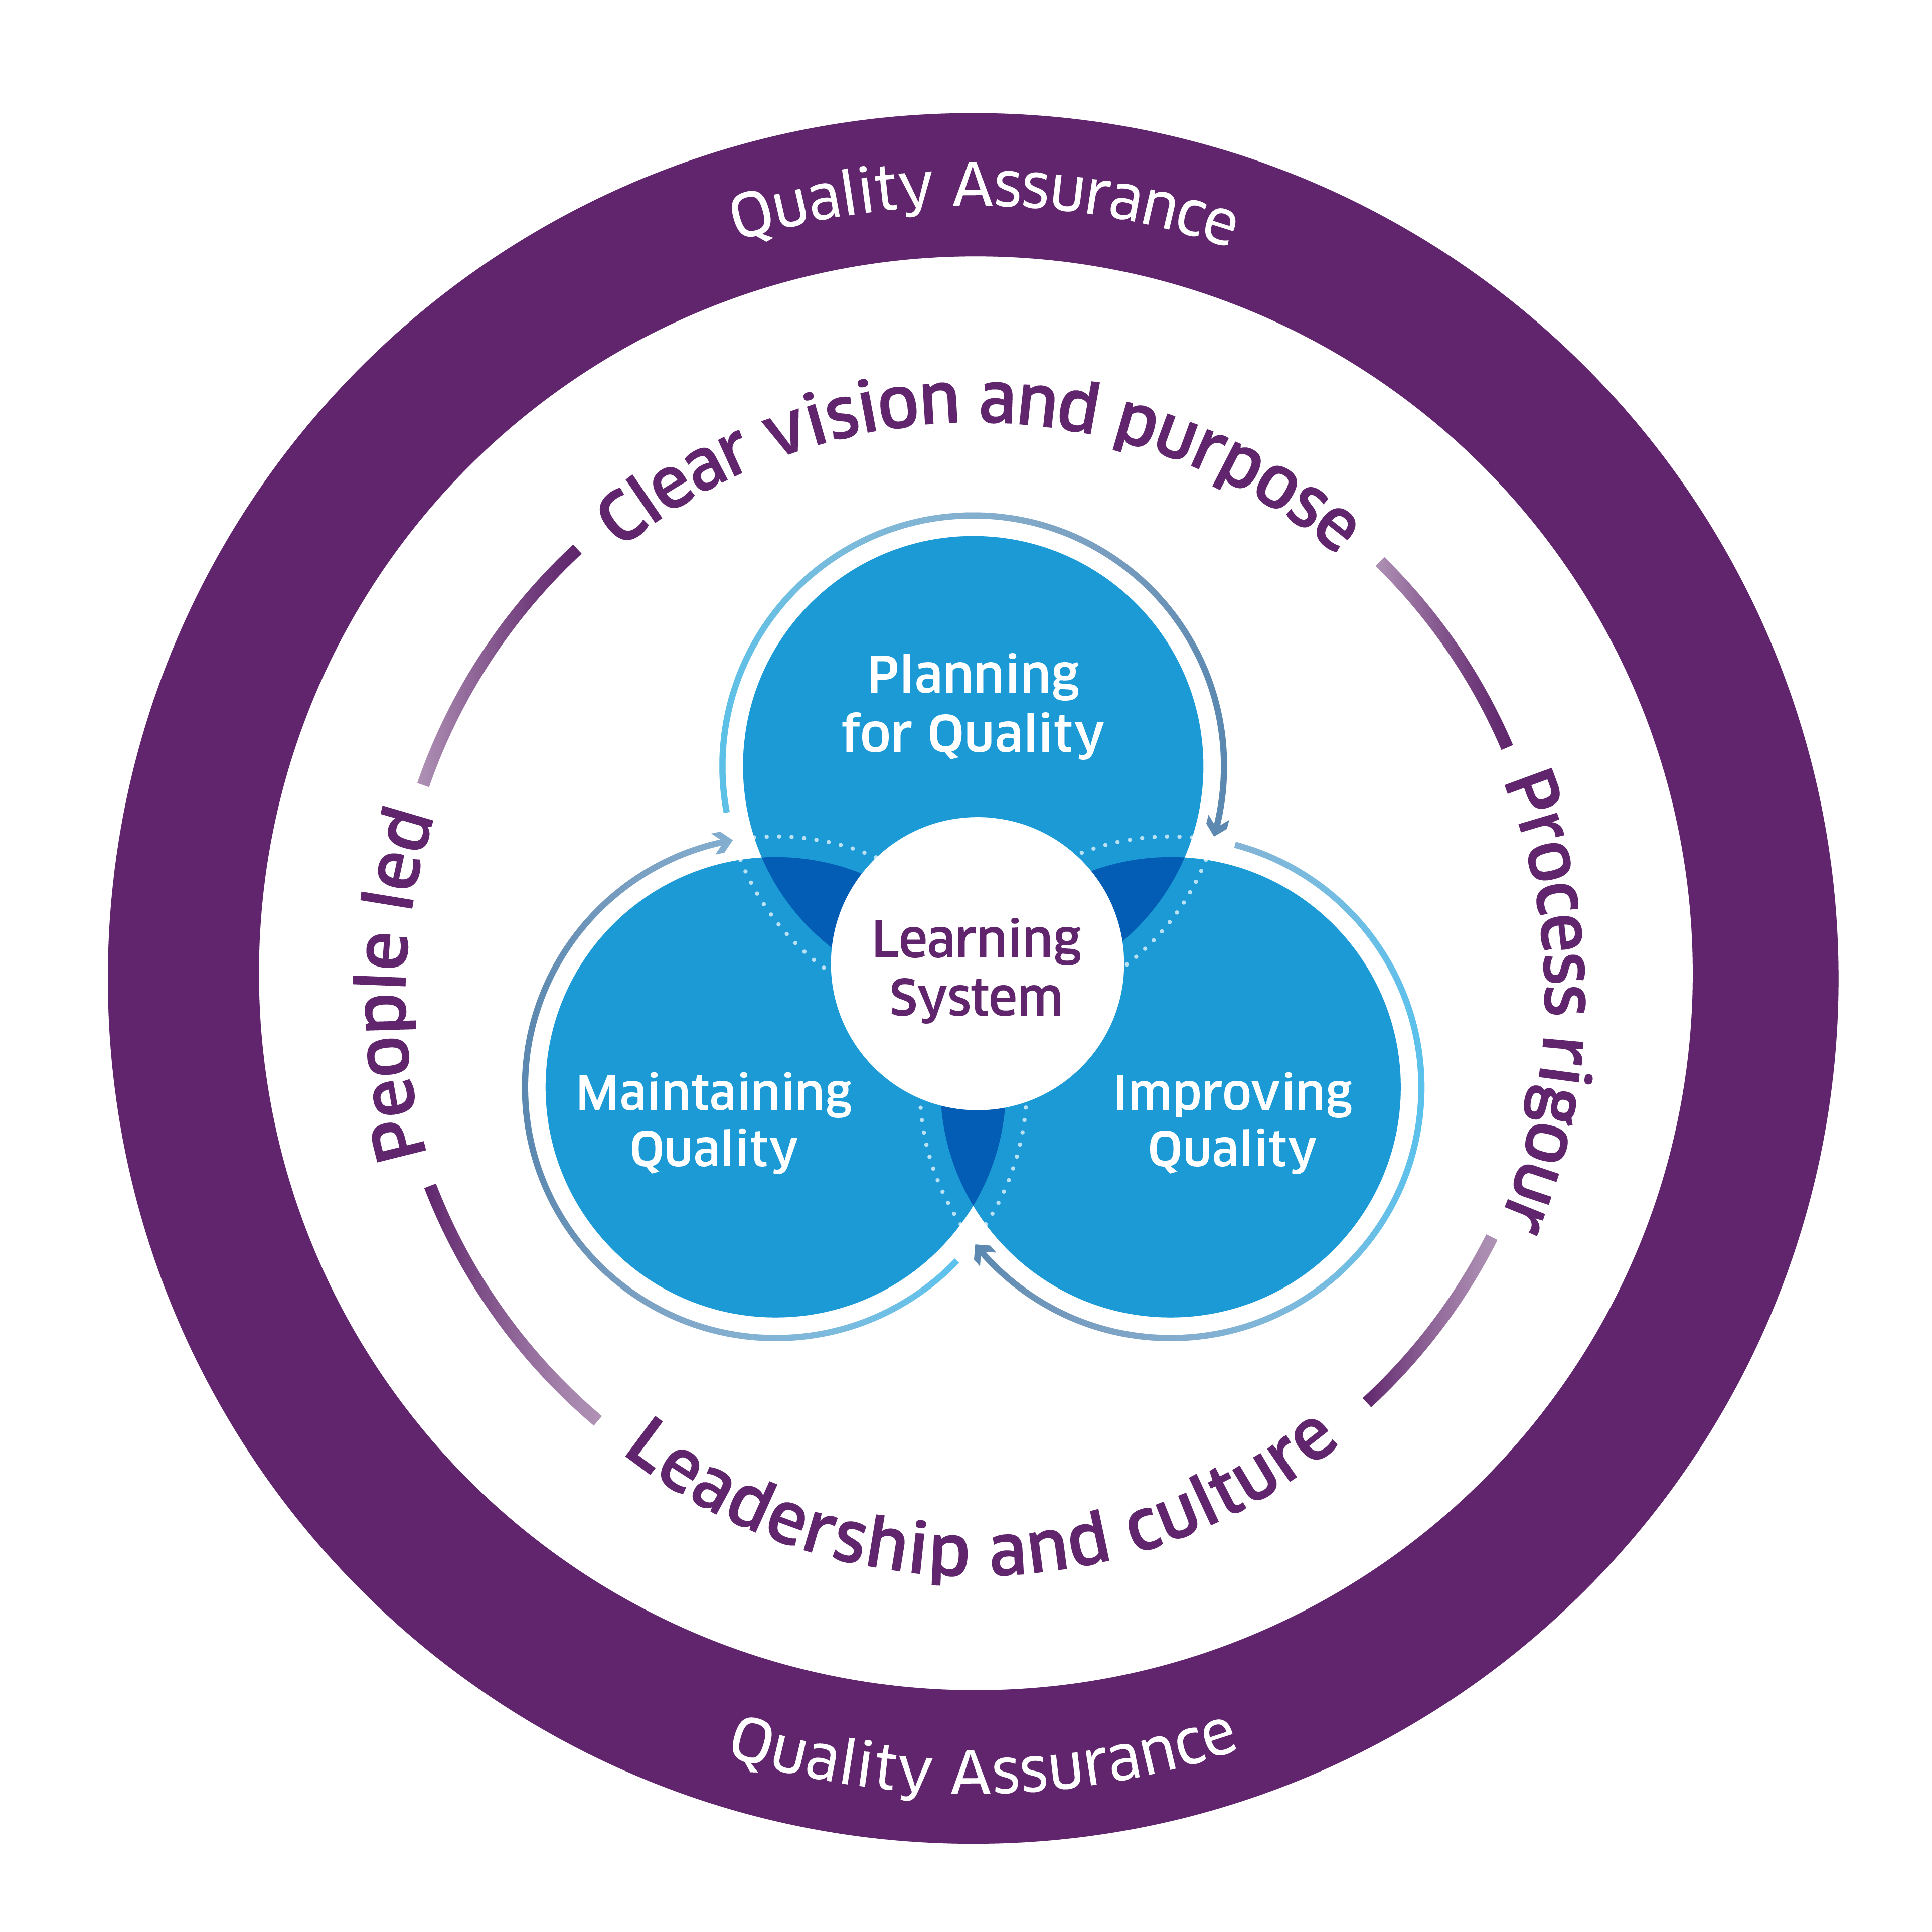
The Enablers of Quality and Change

Slide 5

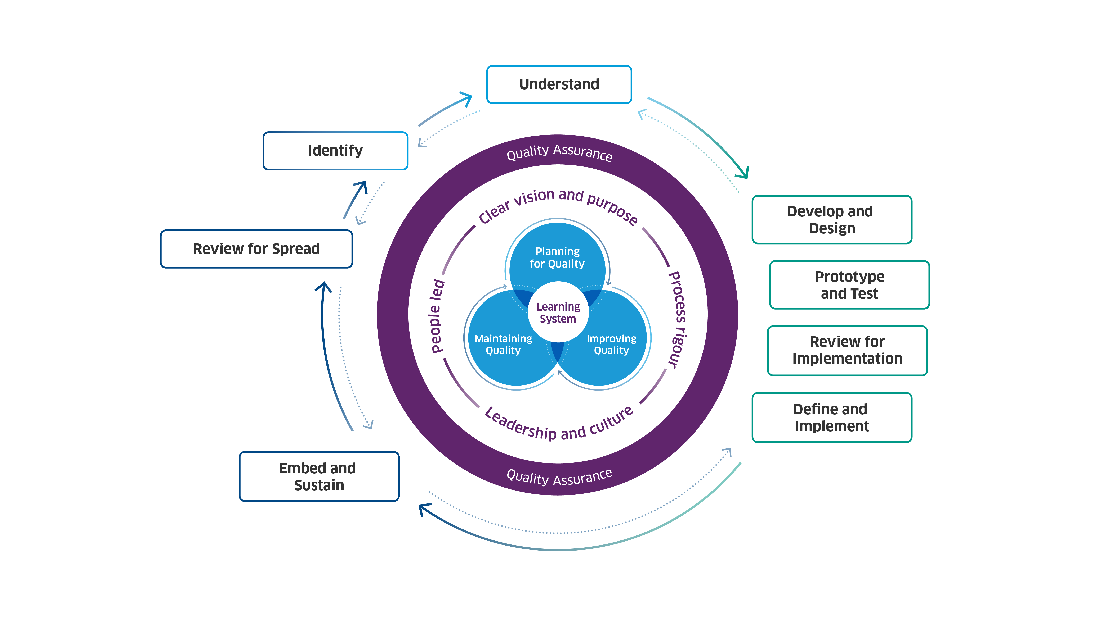
Scottish Approach to Change 2025
© Healthcare Improvement Scotland. Published: 2025

Slide 6
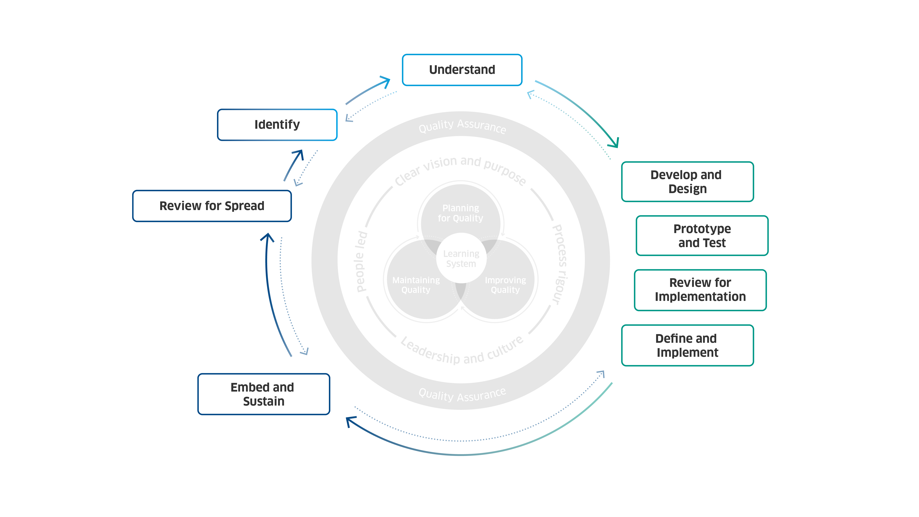
Scottish Approach to Change 2025
© Healthcare Improvement Scotland. Published: 2025

Slide 7
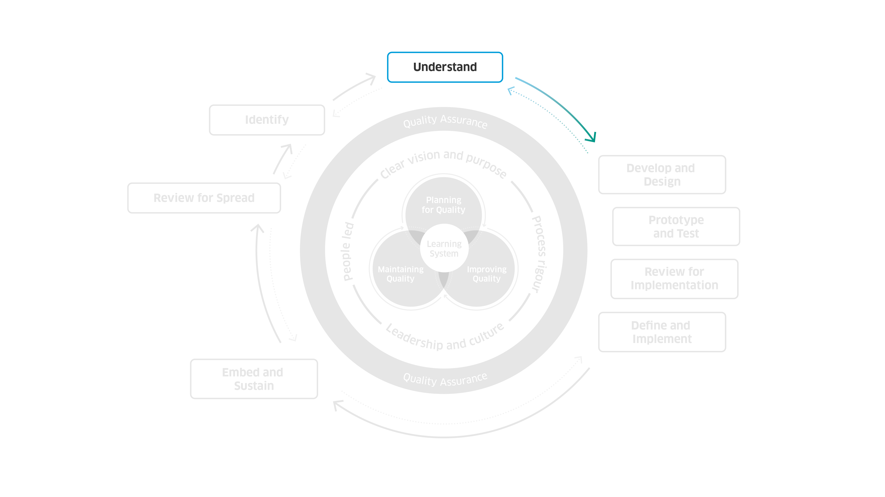
Scottish Approach to Change 2025
© Healthcare Improvement Scotland. Published: 2025

Slide 8
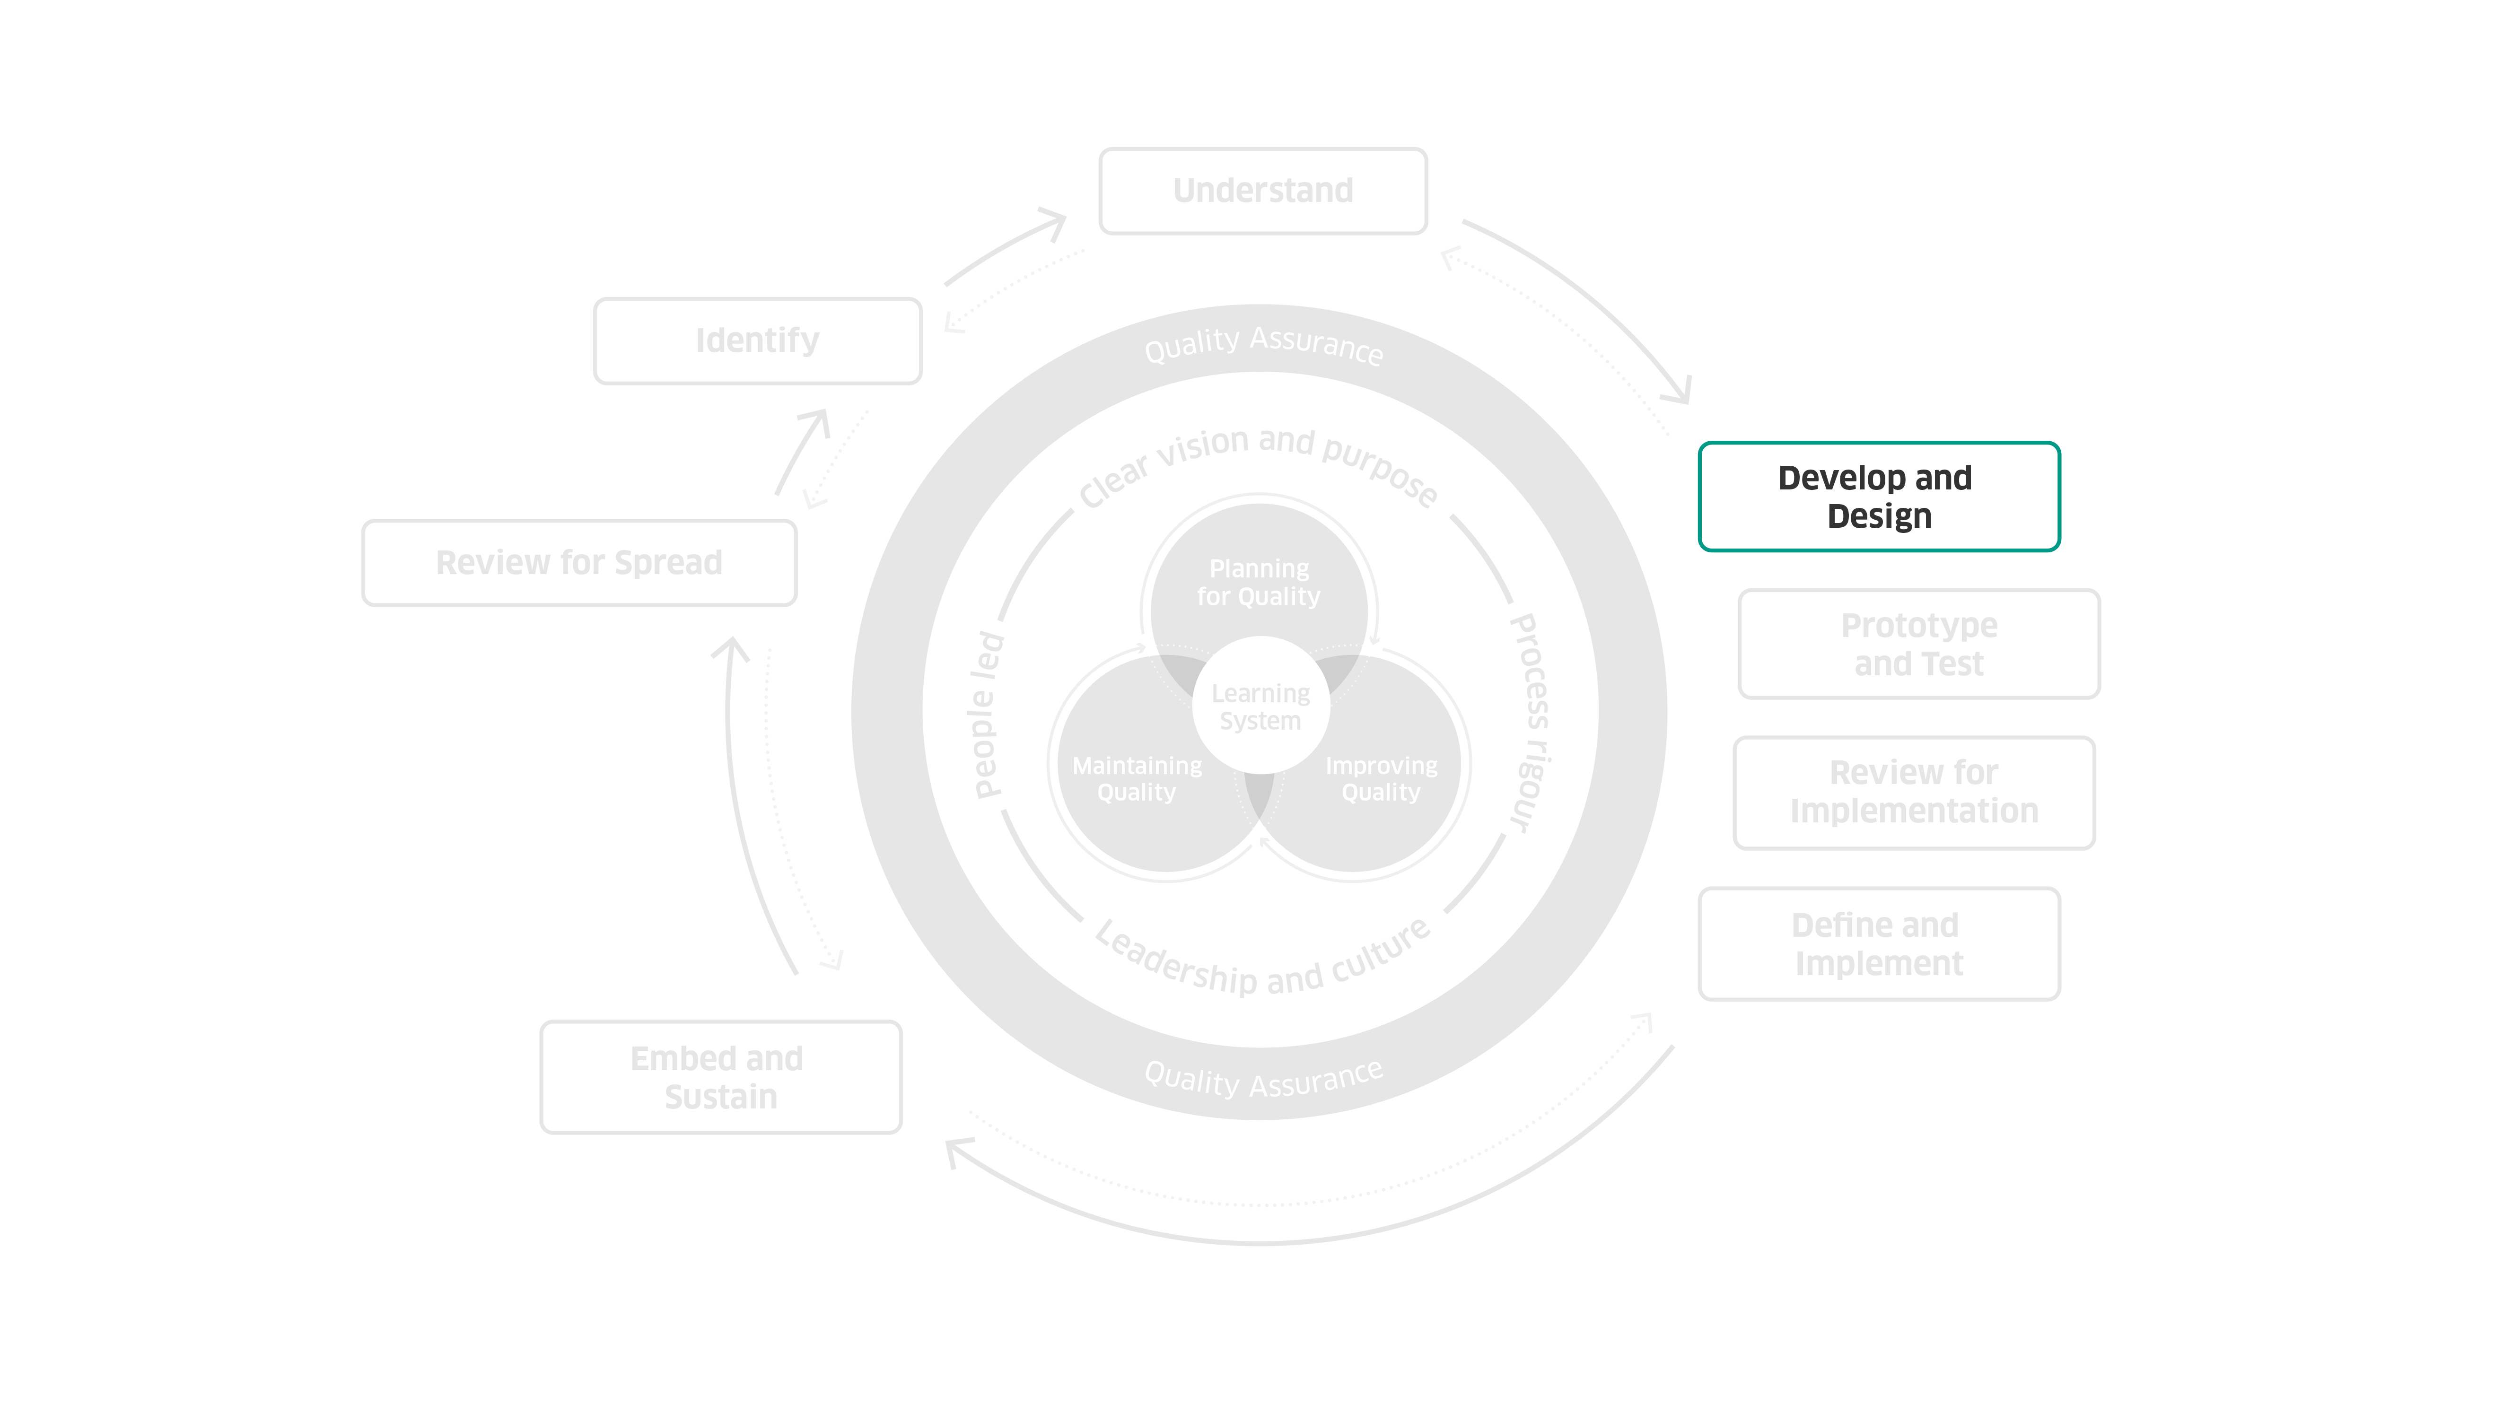
Scottish Approach to Change 2025
© Healthcare Improvement Scotland. Published: 2025

Slide 9
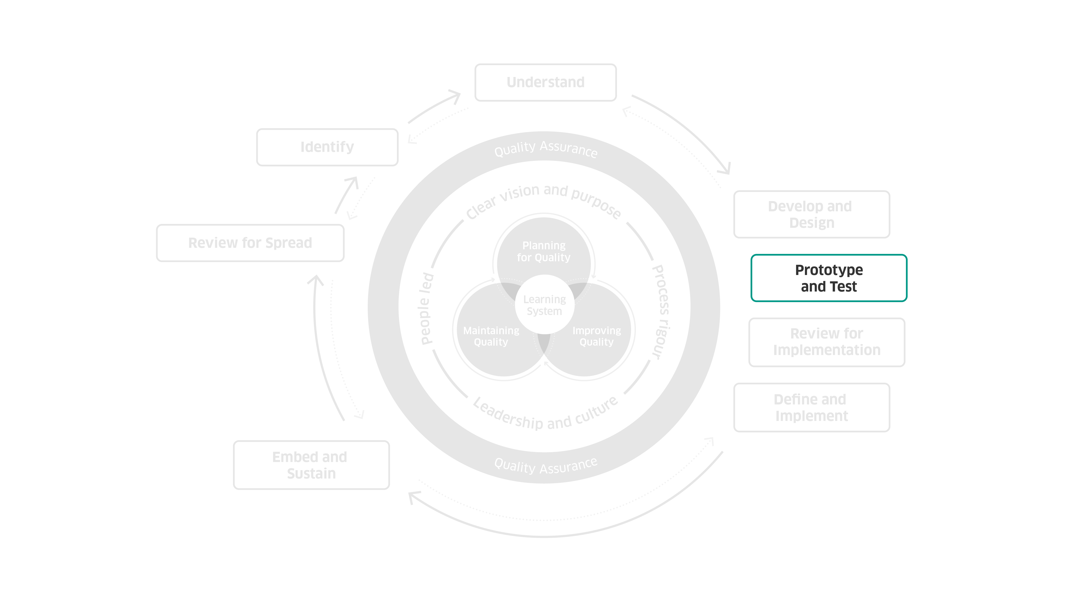
Scottish Approach to Change 2025
© Healthcare Improvement Scotland. Published: 2025

Slide 10
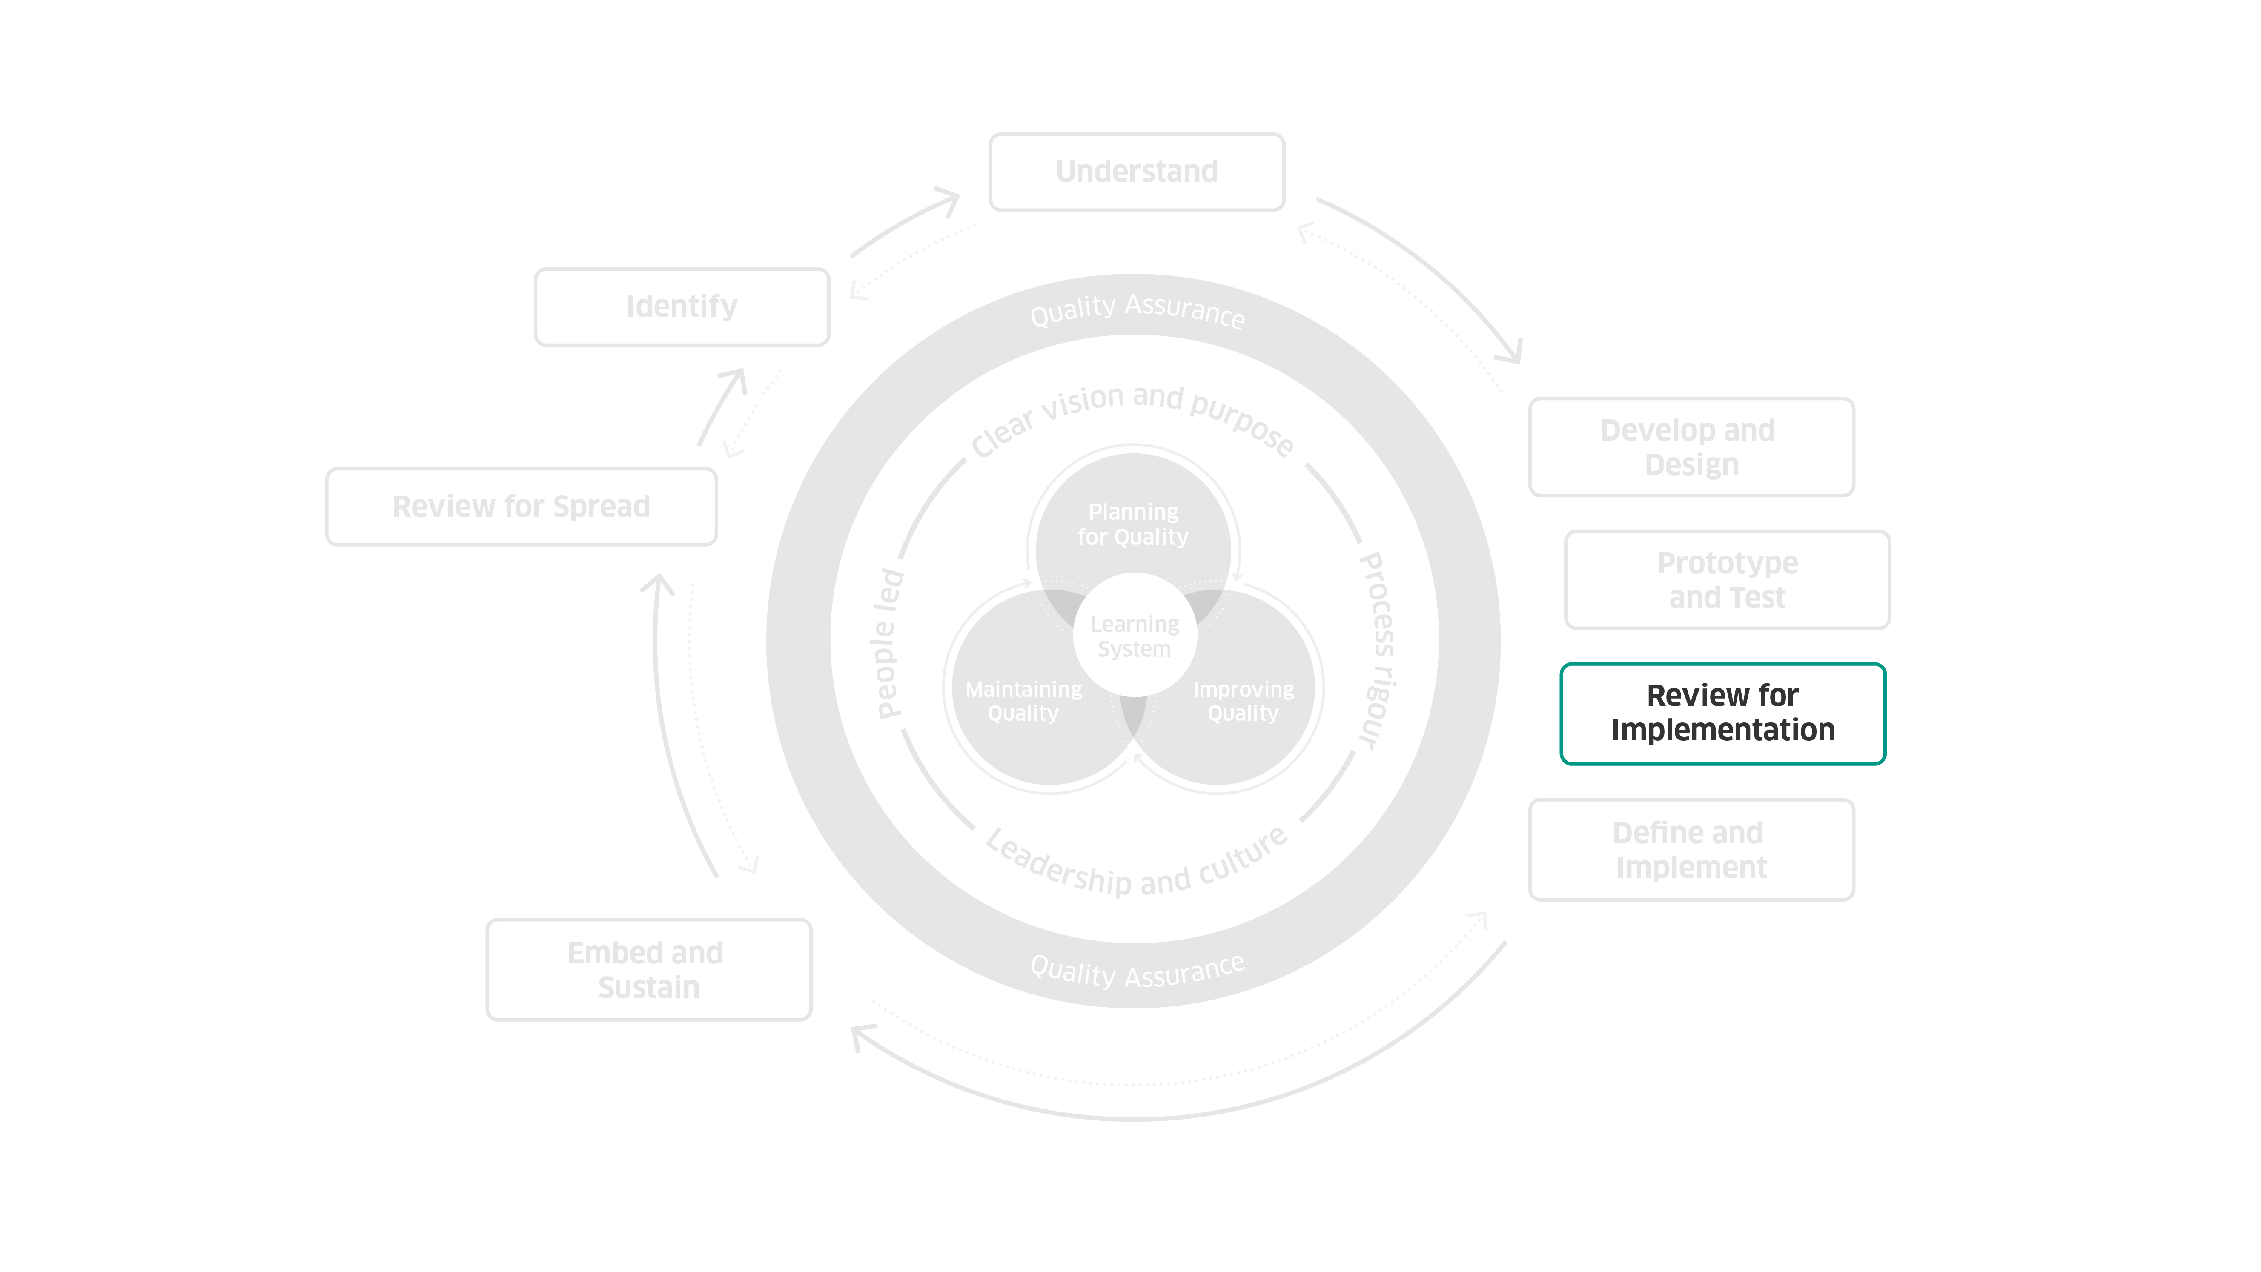
Scottish Approach to Change 2025
© Healthcare Improvement Scotland. Published: 2025

Slide 11
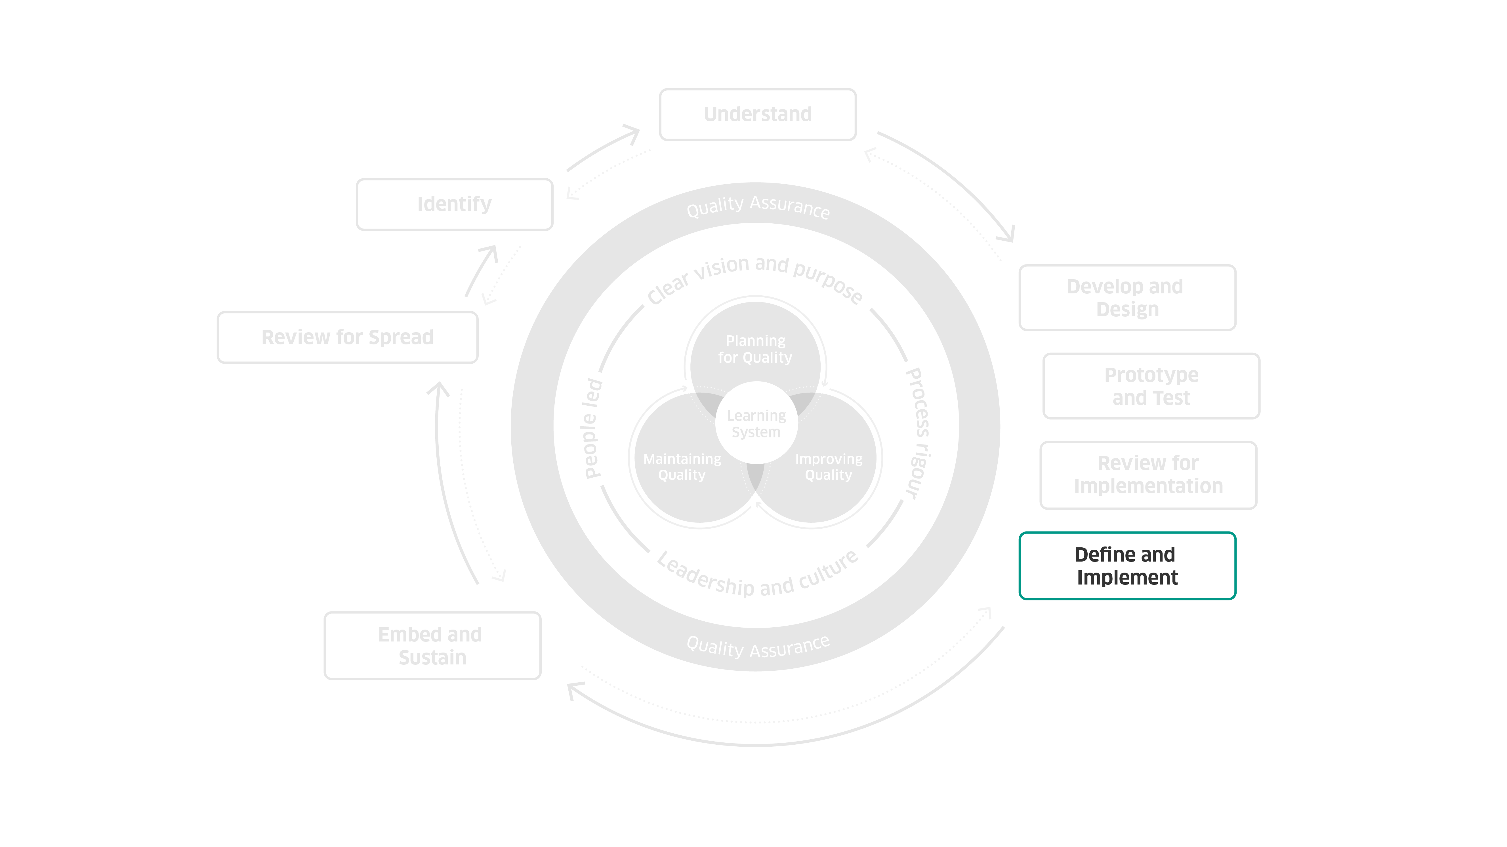
Scottish Approach to Change 2025
© Healthcare Improvement Scotland. Published: 2025

Slide 12
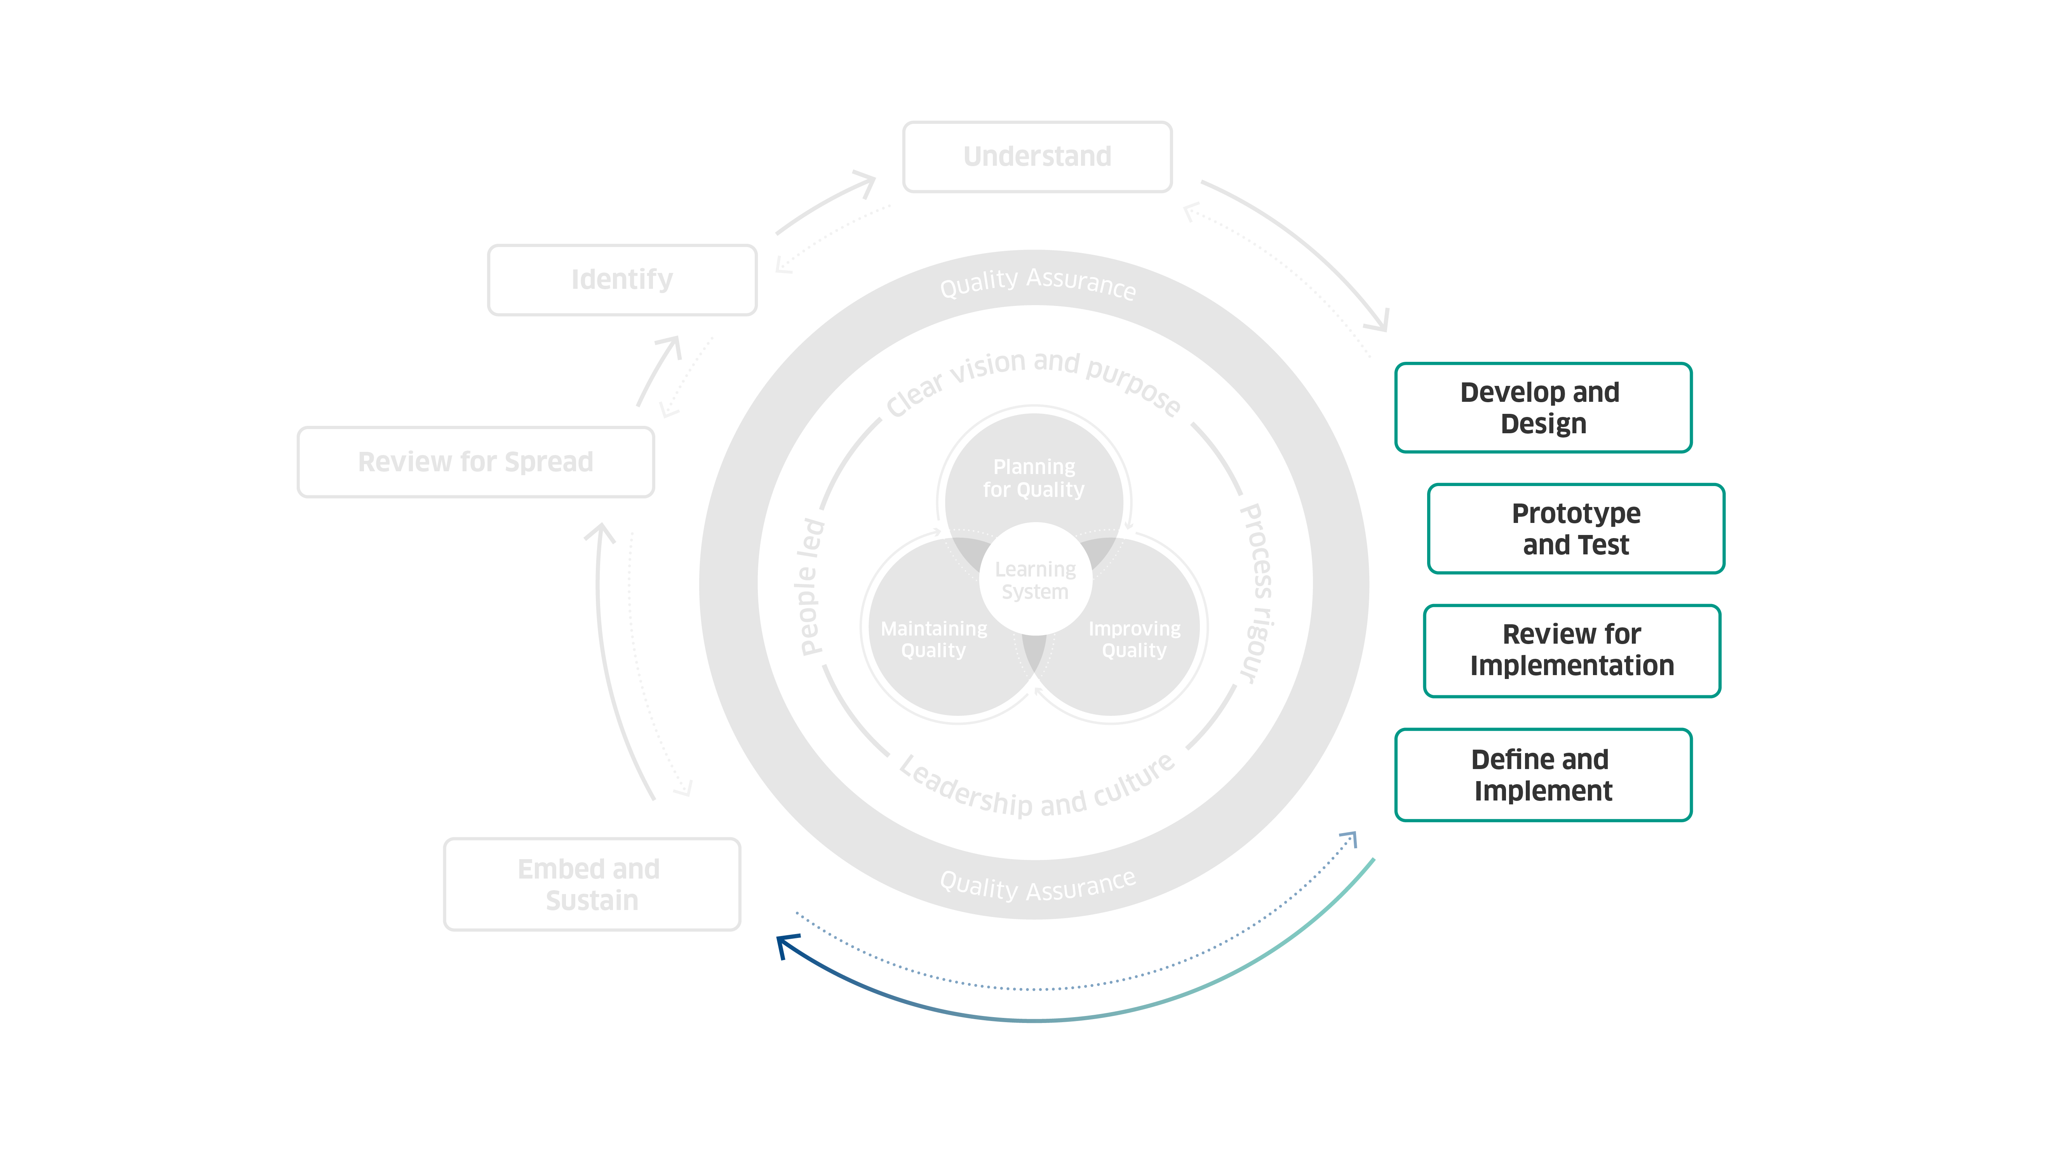
Scottish Approach to Change 2025
© Healthcare Improvement Scotland. Published: 2025

Slide 13
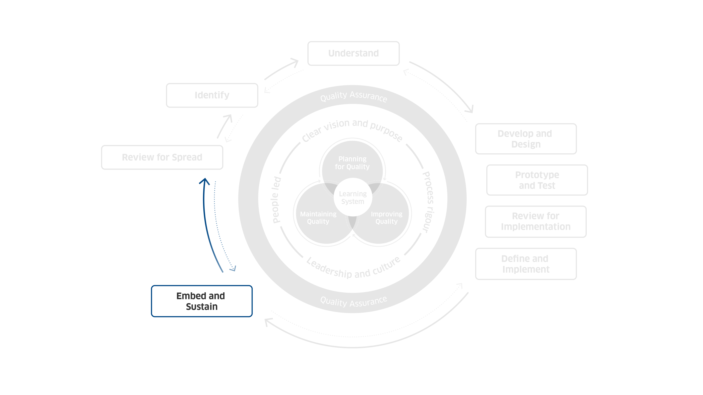
Scottish Approach to Change 2025
© Healthcare Improvement Scotland. Published: 2025

Slide 14
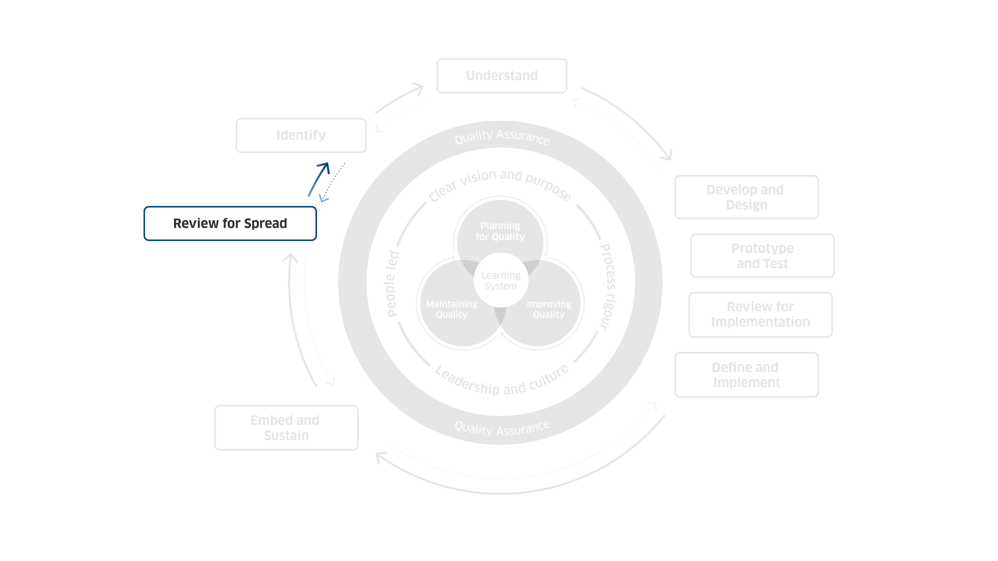
Scottish Approach to Change 2025
© Healthcare Improvement Scotland. Published: 2025

Slide 15
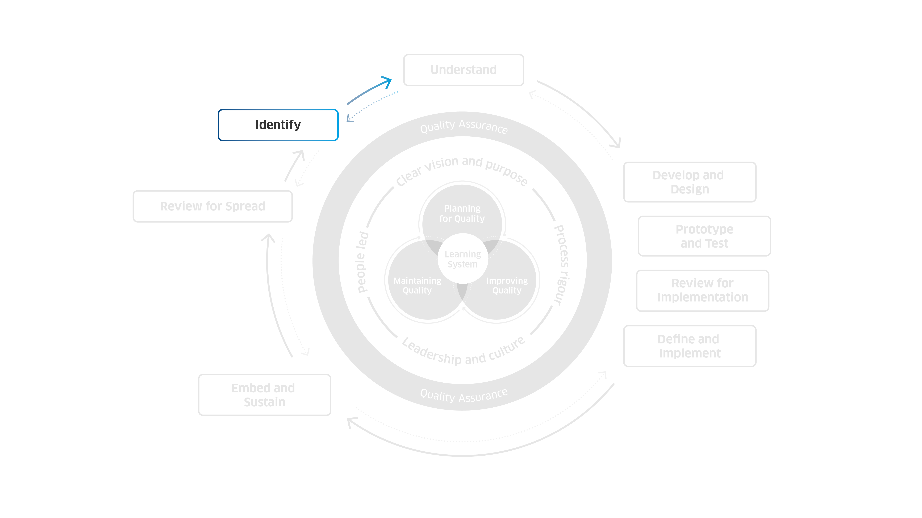
Scottish Approach to Change 2025
© Healthcare Improvement Scotland. Published: 2025

Slide 16
Scottish Approach to Change 2025
© Healthcare Improvement Scotland. Published: 2025

Slide 17
Scottish Approach to Change 2025
© Healthcare Improvement Scotland. Published: 2025

Slide 18

Enablers of Quality and Change

Slide 19

Clear vision and purpose
Define a clear vision and purpose that drives your change. It:
Unites us and builds momentum behind a single direction.
Is tangible and actionable, it doesn’t shy away from hard choices.

Slide 20

Process rigour
Outline a rigorous approach to how you understand change. It:
Adds clarity to we are doing, when and why - it brings calm to the noise of change.
Helps increase our confidence in decision making, supporting momentum in uncertainty and complexity.

Slide 21

Leadership and culture
Create the conditions for change to thrive through setting the right culture and leadership. It:
Sets the vision, empowers others and unblocks barriers to change.
Sees leaders stepping into change, playing an active role.

Slide 22

People-led
Take a people-led approach by inviting people to design and deliver change together. It values:
Meaningful engagement as vital, not an additional ‘thing to do’.
People articulating their own needs and supports them to do so meaningfully.
The needs of people over the needs of the system - services belong to people.

Slide 23

Learning system
Embed a learning culture to support your change programme sustainably. It:
Is a superpower – it unlocks knowledge, solutions, energy, momentum and brilliance.
Requires commitment, it challenges our engrained values and behaviours, and needs continued practice.

Slide 24
Clear vision and purpose
Clear vision and purpose
Define a clear vision and purpose that drives your change.

Slide 25
Process rigour
Process rigour
Outline a rigorous approach to how you understand change.

Slide 26
Leadership and culture
Leadership and culture
Create the conditions for change to thrive through setting the right culture and leadership.

Slide 27
People-led
People-led
Take a people-led approach by inviting people to design and deliver change together.

Slide 28
Learning system
Learning system
Embed a learning culture to support your change programme sustainably.

Slide 29
Vision and purpose

Slide 30
Vision and purpose
Process rigour

Slide 31
Vision and purpose
Process rigour
Leadership and culture

Slide 32
Vision and purpose
Process rigour
Leadership and culture
People-led

Slide 33
Vision and purpose
Process rigour
Leadership and culture
People-led
Learning system

Slide 34
Vision and purpose

Slide 35
Vision and purpose
Process rigour

Slide 36
Vision and purpose
Process rigour
Leadership and culture

Slide 37
Vision and purpose
Process rigour
Leadership and culture
People-led

Slide 38
Vision and purpose
Process rigour
Leadership and culture
People-led
Learning system

Slide 39
Vision and purpose

Slide 40
Vision and purpose
Process rigour

Slide 41
Vision and purpose
Process rigour
Leadership and culture

Slide 42
Vision and purpose
Process rigour
Leadership and culture
People-led

Slide 43
Vision and purpose
Process rigour
Leadership and culture
People-led
Learning system

Slide 44
Vision and purpose

Slide 45
Vision and purpose
Process rigour

Slide 46
Vision and purpose
Process rigour
Leadership and culture

Slide 47
Vision and purpose
Process rigour
Leadership and culture
People-led

Slide 48
Vision and purpose
Process rigour
Leadership and culture
People-led
Learning system

Slide 49

Steps of Change

Slide 50

Identify
Identify
Identifying the need for change can come from many sources. You can learn from staff, service users, new technologies, or updates in policy and strategy.

Slide 51

Understand
Understand
Understanding the challenge or opportunity you have found is key. It helps you choose the best option for change and guides your approach to making it happen.

Slide 52

Develop and design
Develop and design
Developing and designing your options and collaborating with others to develop better solutions.

Slide 53

Prototype and test
Prototype and test
Prototyping and testing what works and what does not work, allowing you to continue improving and refining your change.

Slide 54

Review for implementation
Review for implementation
Reviewing for implementation to reflect on where you are and deciding how you want to continue.

Slide 55

Define and implement
Define and implement
Defining and implementing how you will support teams in enabling that change as part of business as usual

Slide 56

Embed and sustain
Embed and sustain
Embedding and sustaining as part of routine and culture.

Slide 57

Review for spread
Review for spread
Reviewing which ideas to spread, why or why not, and what might be required to do this.

Slide 58
Identify

Slide 59
Identify
Understand

Slide 60
Identify
Understand
Develop and design

Slide 61
Identify
Understand
Develop and design
Prototype and test

Slide 62
Identify
Understand
Develop and design
Prototype and test
Review for implementation

Slide 63
Identify
Understand
Develop and design
Prototype and test
Review for implementation
Define and implement

Slide 64
Identify
Understand
Develop and design
Prototype and test
Review for implementation
Define and implement
Embed and sustain

Slide 65
Identify
Understand
Develop and design
Prototype and test
Review for implementation
Define and implement
Embed and sustain
Review for spread

Slide 66
Identify

Slide 67
Identify
Understand

Slide 68
Identify
Understand
Develop and design

Slide 69
Identify
Understand
Develop and design
Prototype and test

Slide 70
Identify
Understand
Develop and design
Prototype and test
Review for implementation

Slide 71
Identify
Understand
Develop and design
Prototype and test
Review for implementation
Define and implement

Slide 72
Identify
Understand
Develop and design
Prototype and test
Review for implementation
Define and implement
Embed and sustain

Slide 73
Identify
Understand
Develop and design
Prototype and test
Review for implementation
Define and implement
Embed and sustain
Review for spread

Slide 74
Identify
Understand
Develop and design
Prototype and test
Review for implementation
Define and implement
Embed and sustain
Review for spread

Slide 75
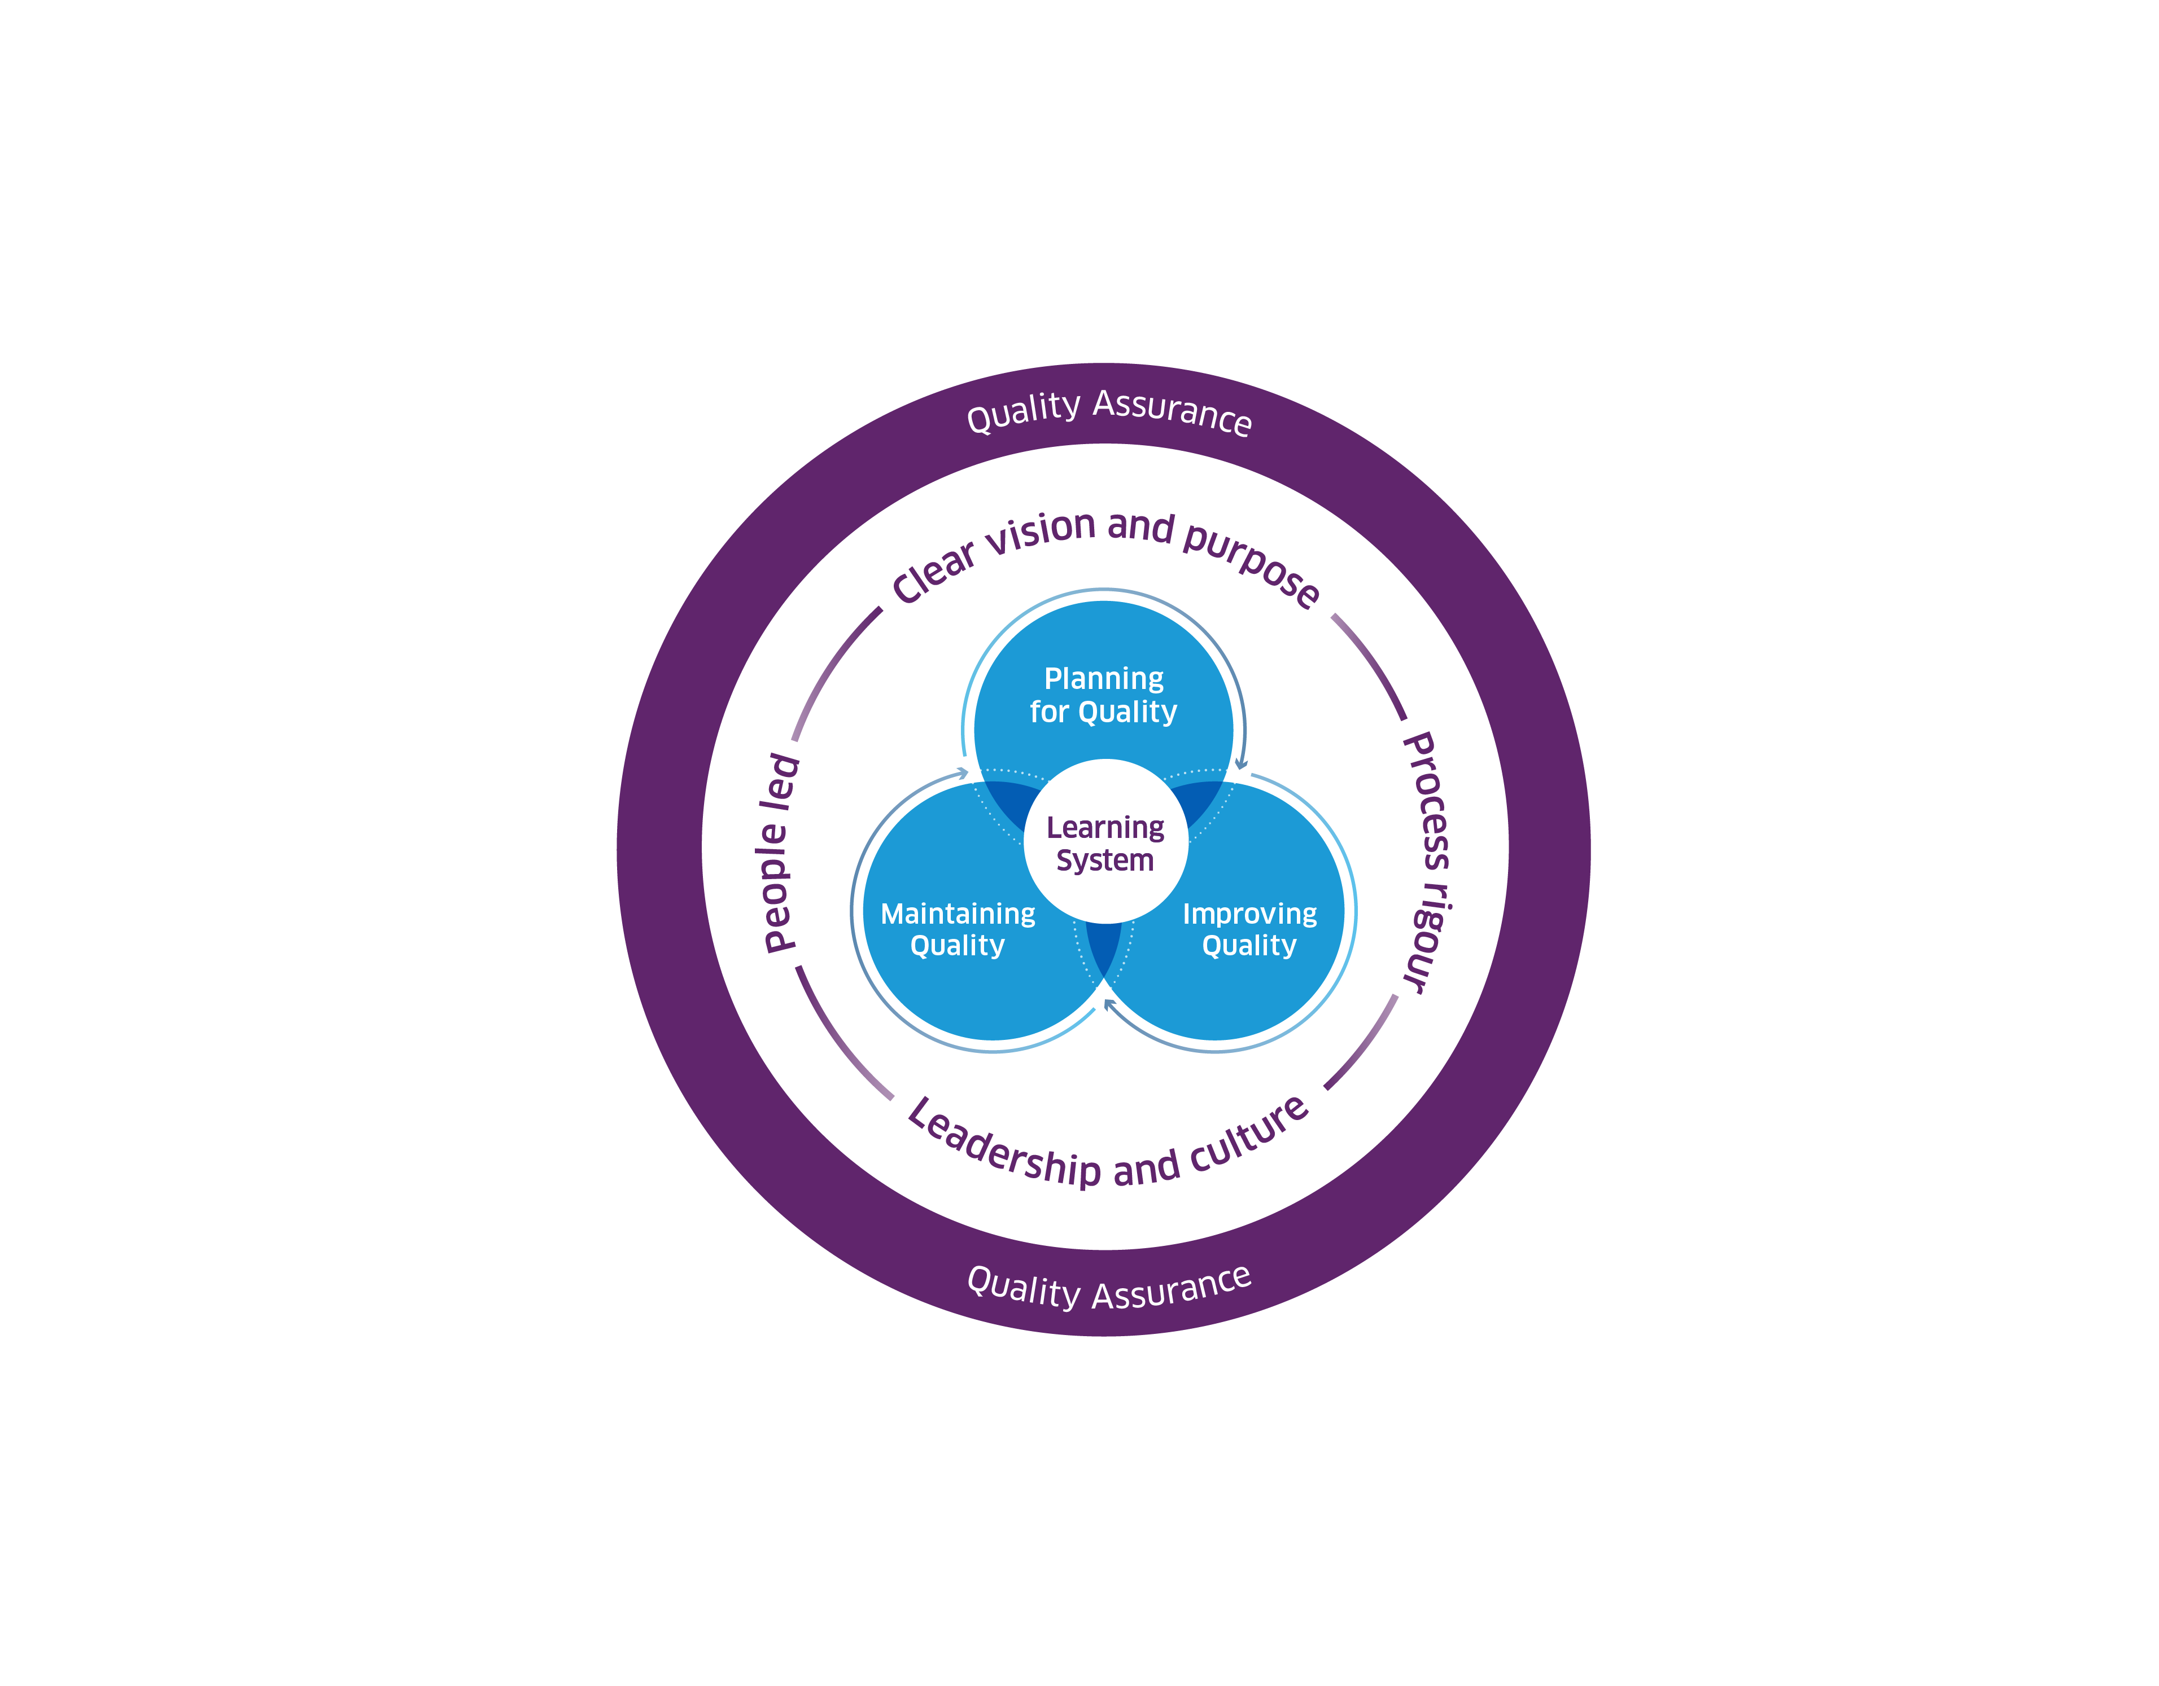
High-level Quality Management System
Framework 2025
© Healthcare Improvement Scotland. Published: 2025

Slide 76
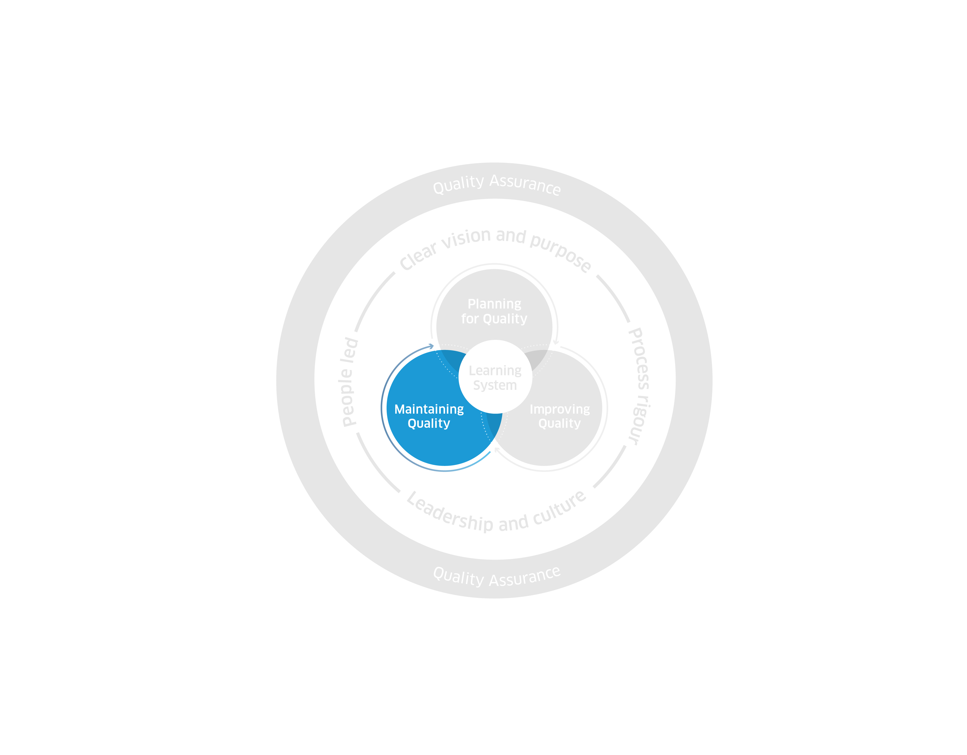
High-level Quality Management System
Framework 2025
© Healthcare Improvement Scotland. Published: 2025

Slide 77
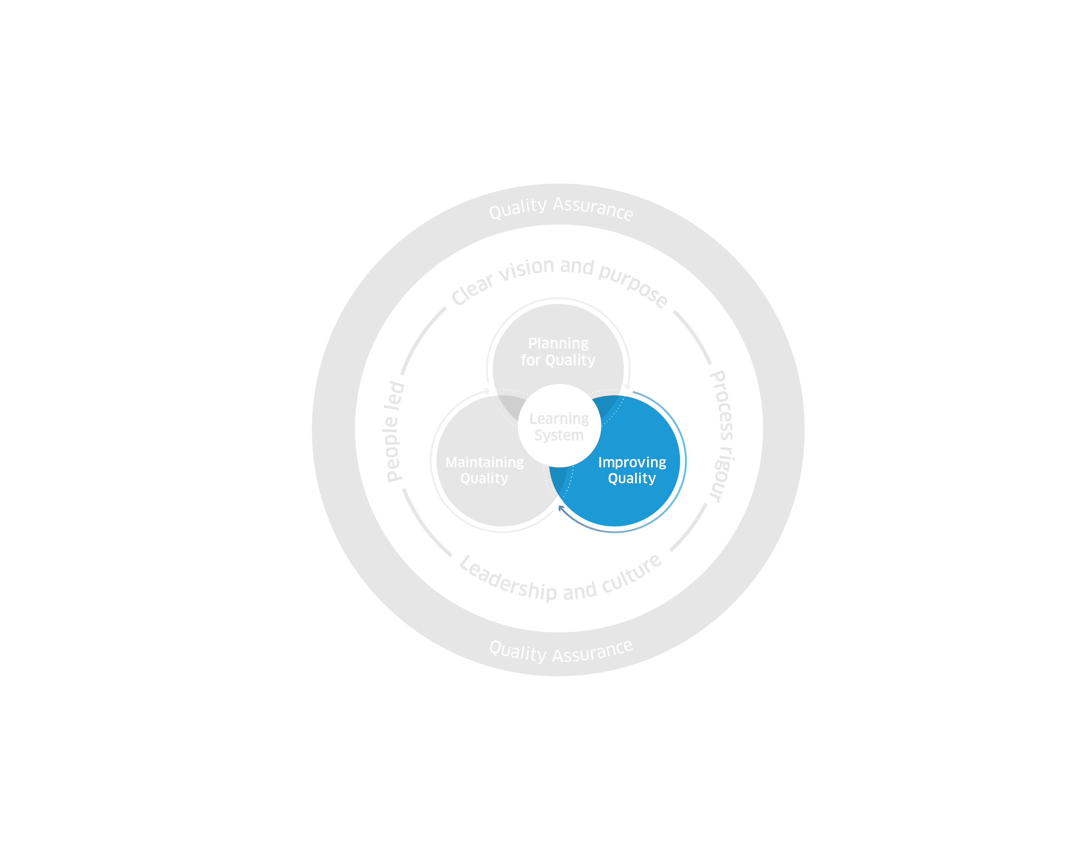
High-level Quality Management System
Framework 2025
© Healthcare Improvement Scotland. Published: 2025

Slide 78
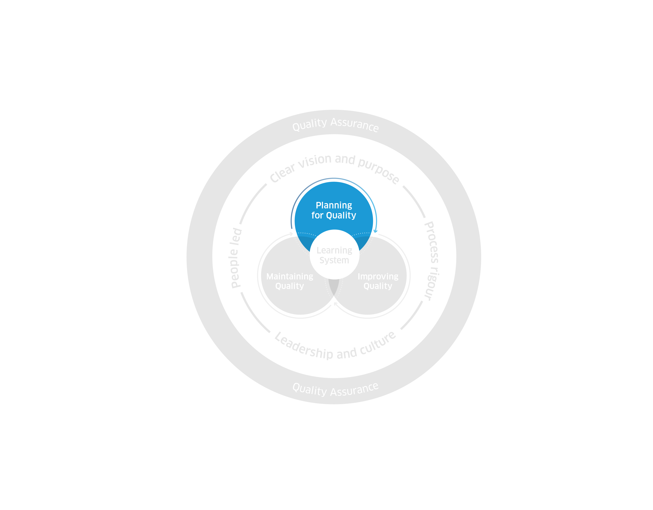
High-level Quality Management System
Framework 2025
© Healthcare Improvement Scotland. Published: 2025

Slide 79
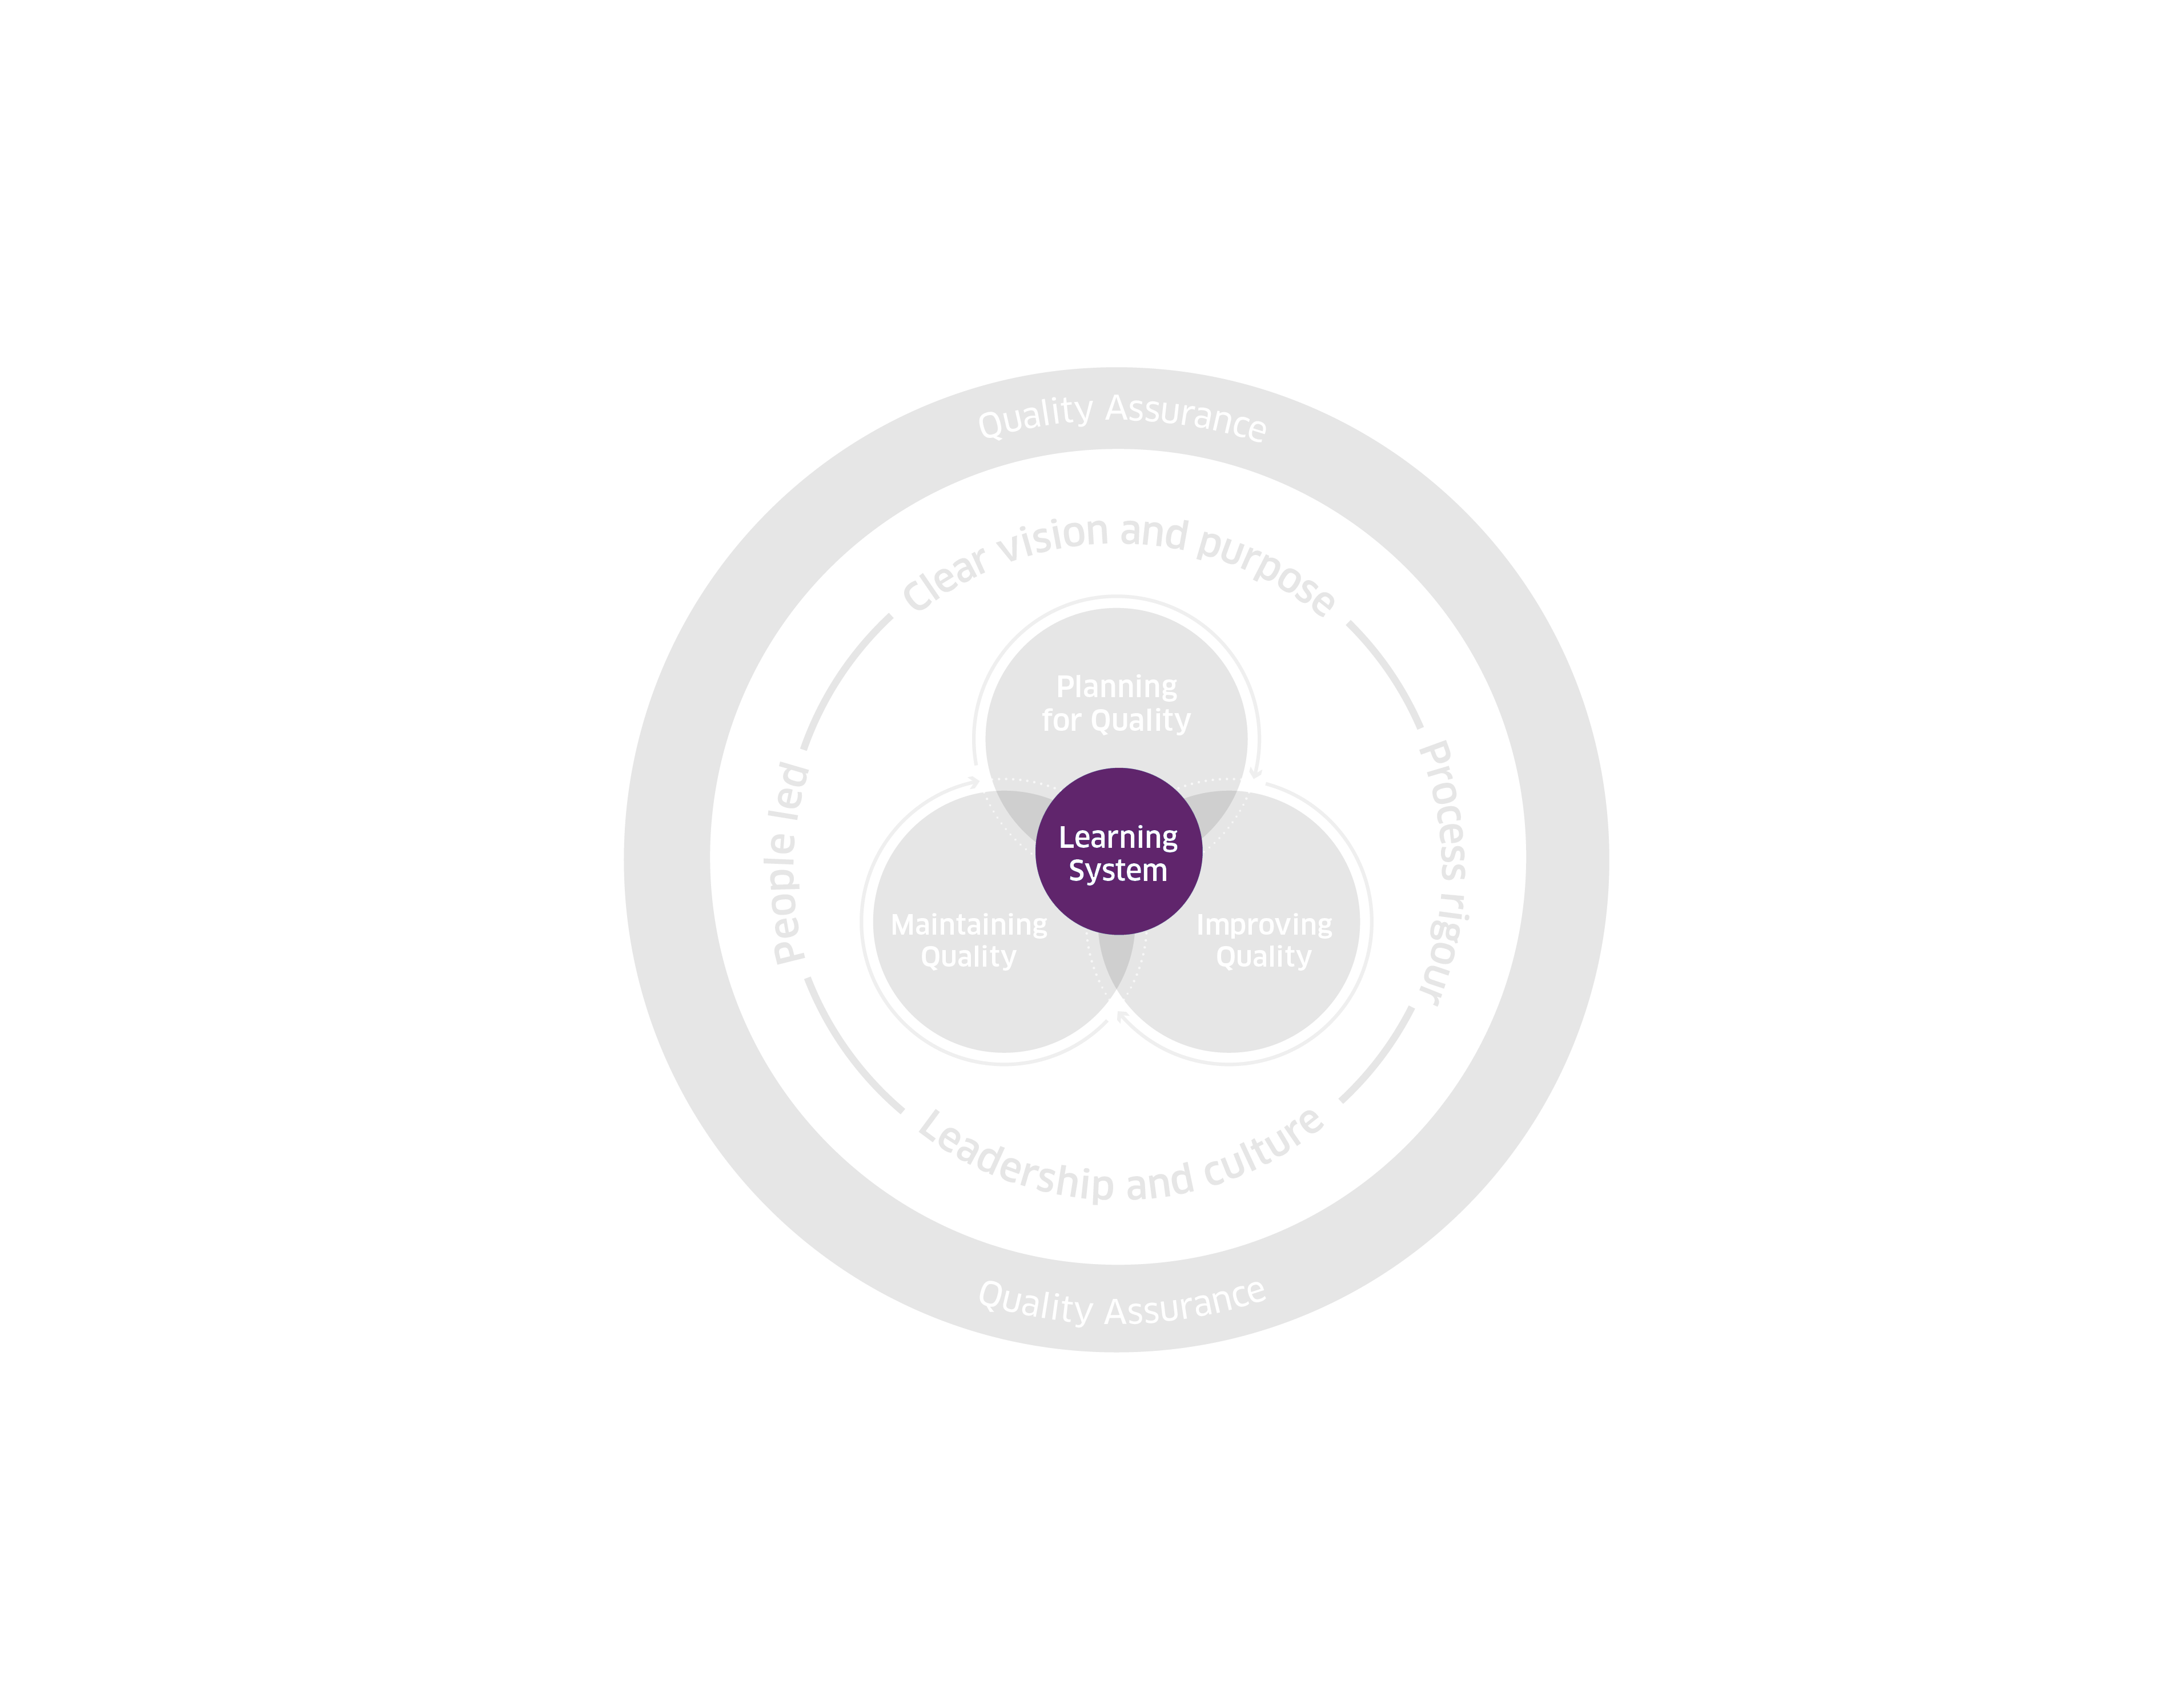
High-level Quality Management System
Framework 2025
© Healthcare Improvement Scotland. Published: 2025

Slide 80
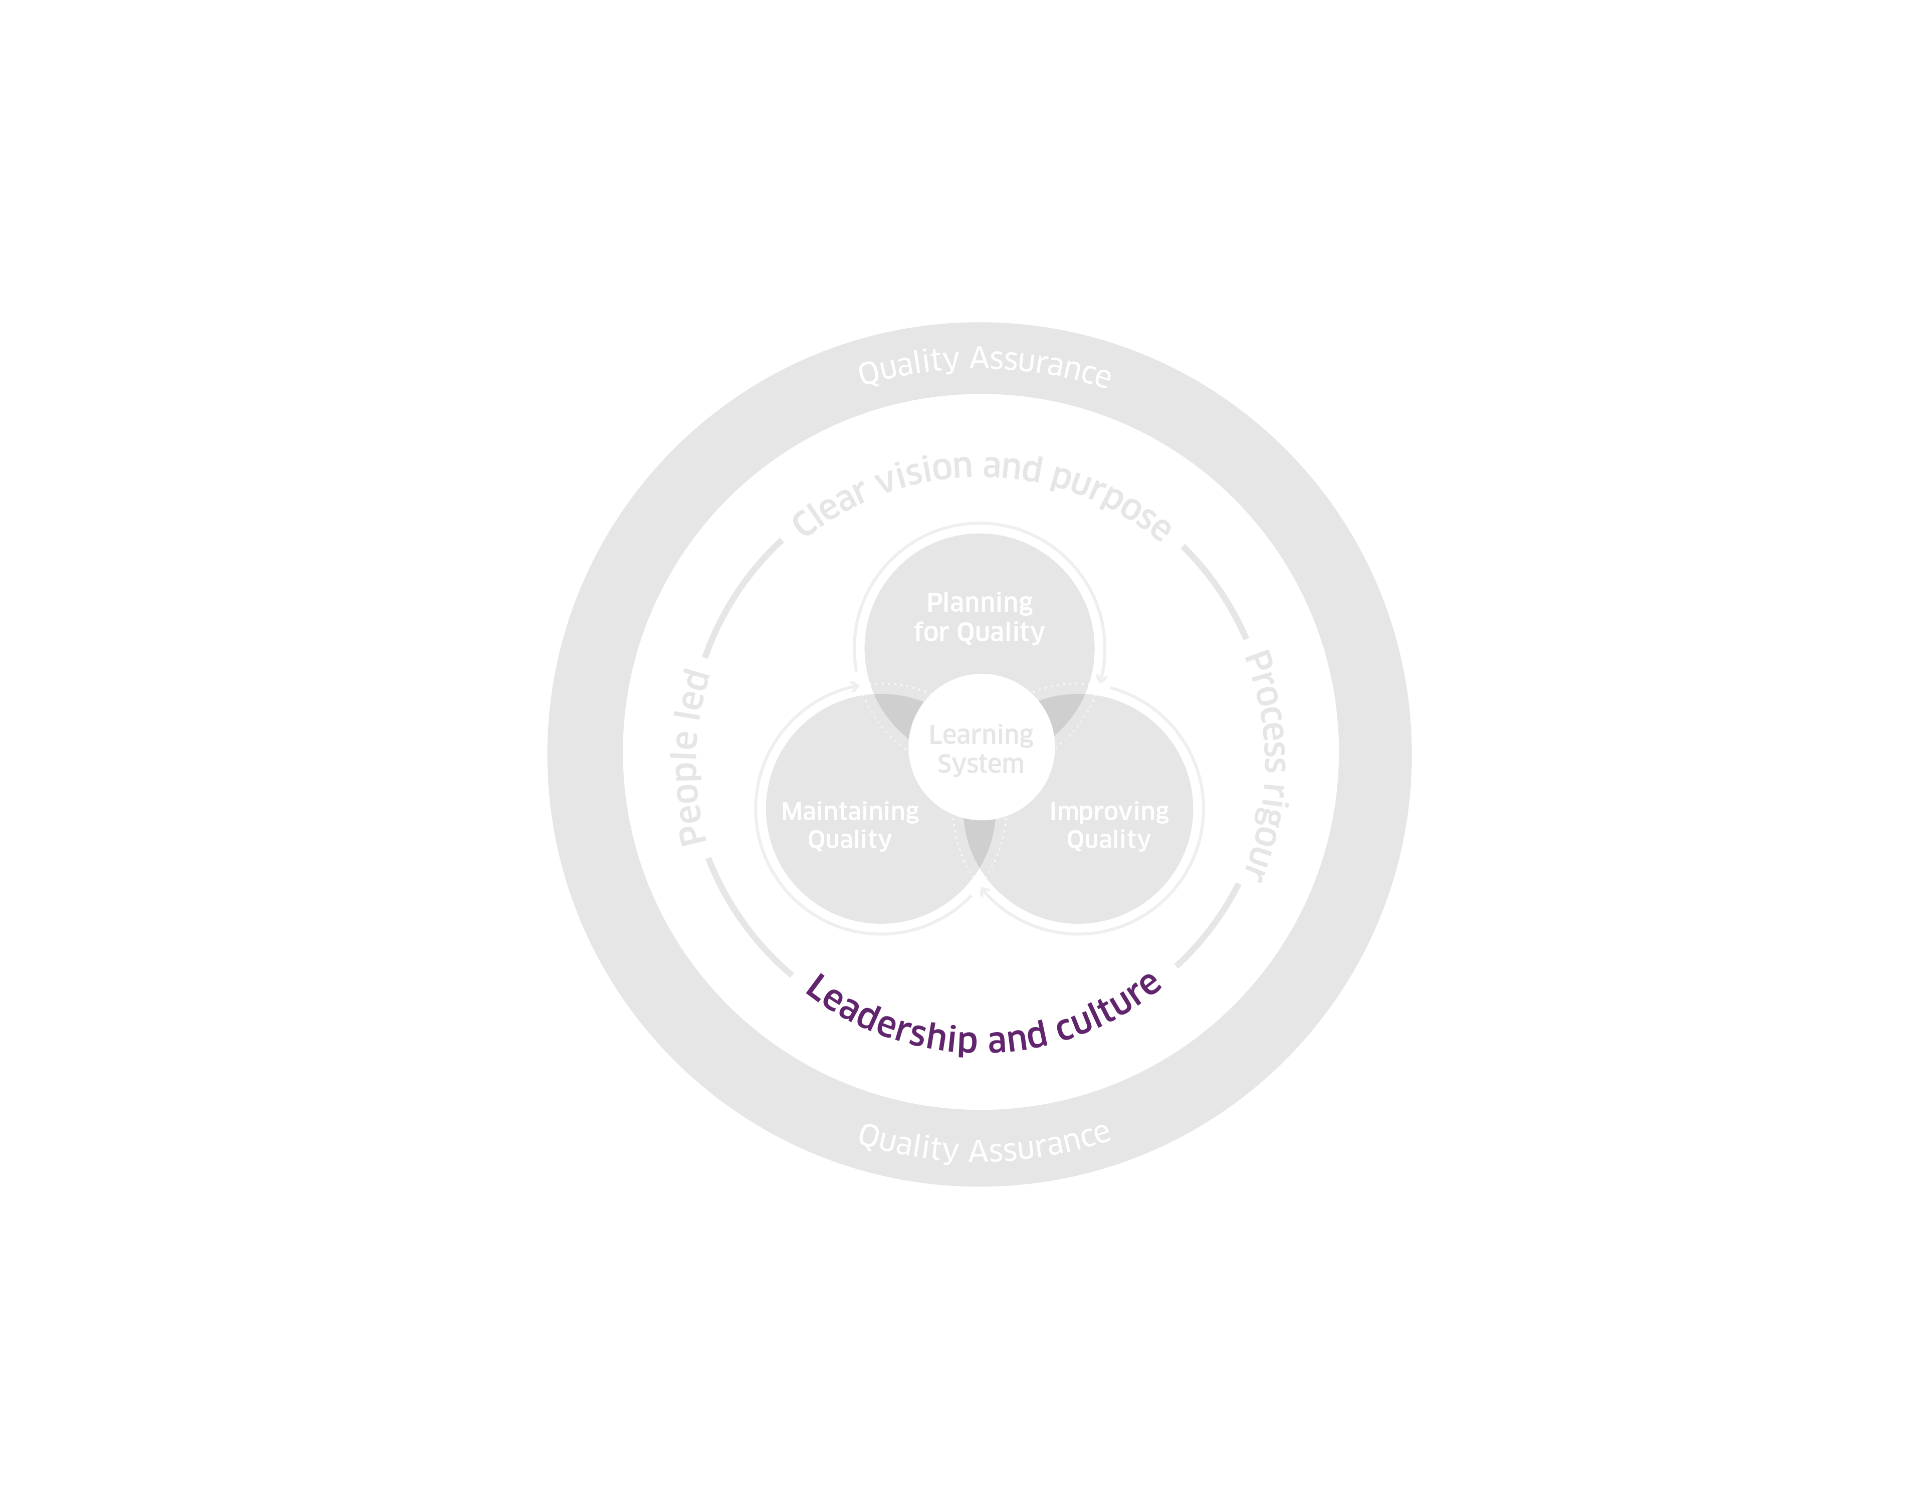
High-level Quality Management System
Framework 2025
© Healthcare Improvement Scotland. Published: 2025

Slide 81
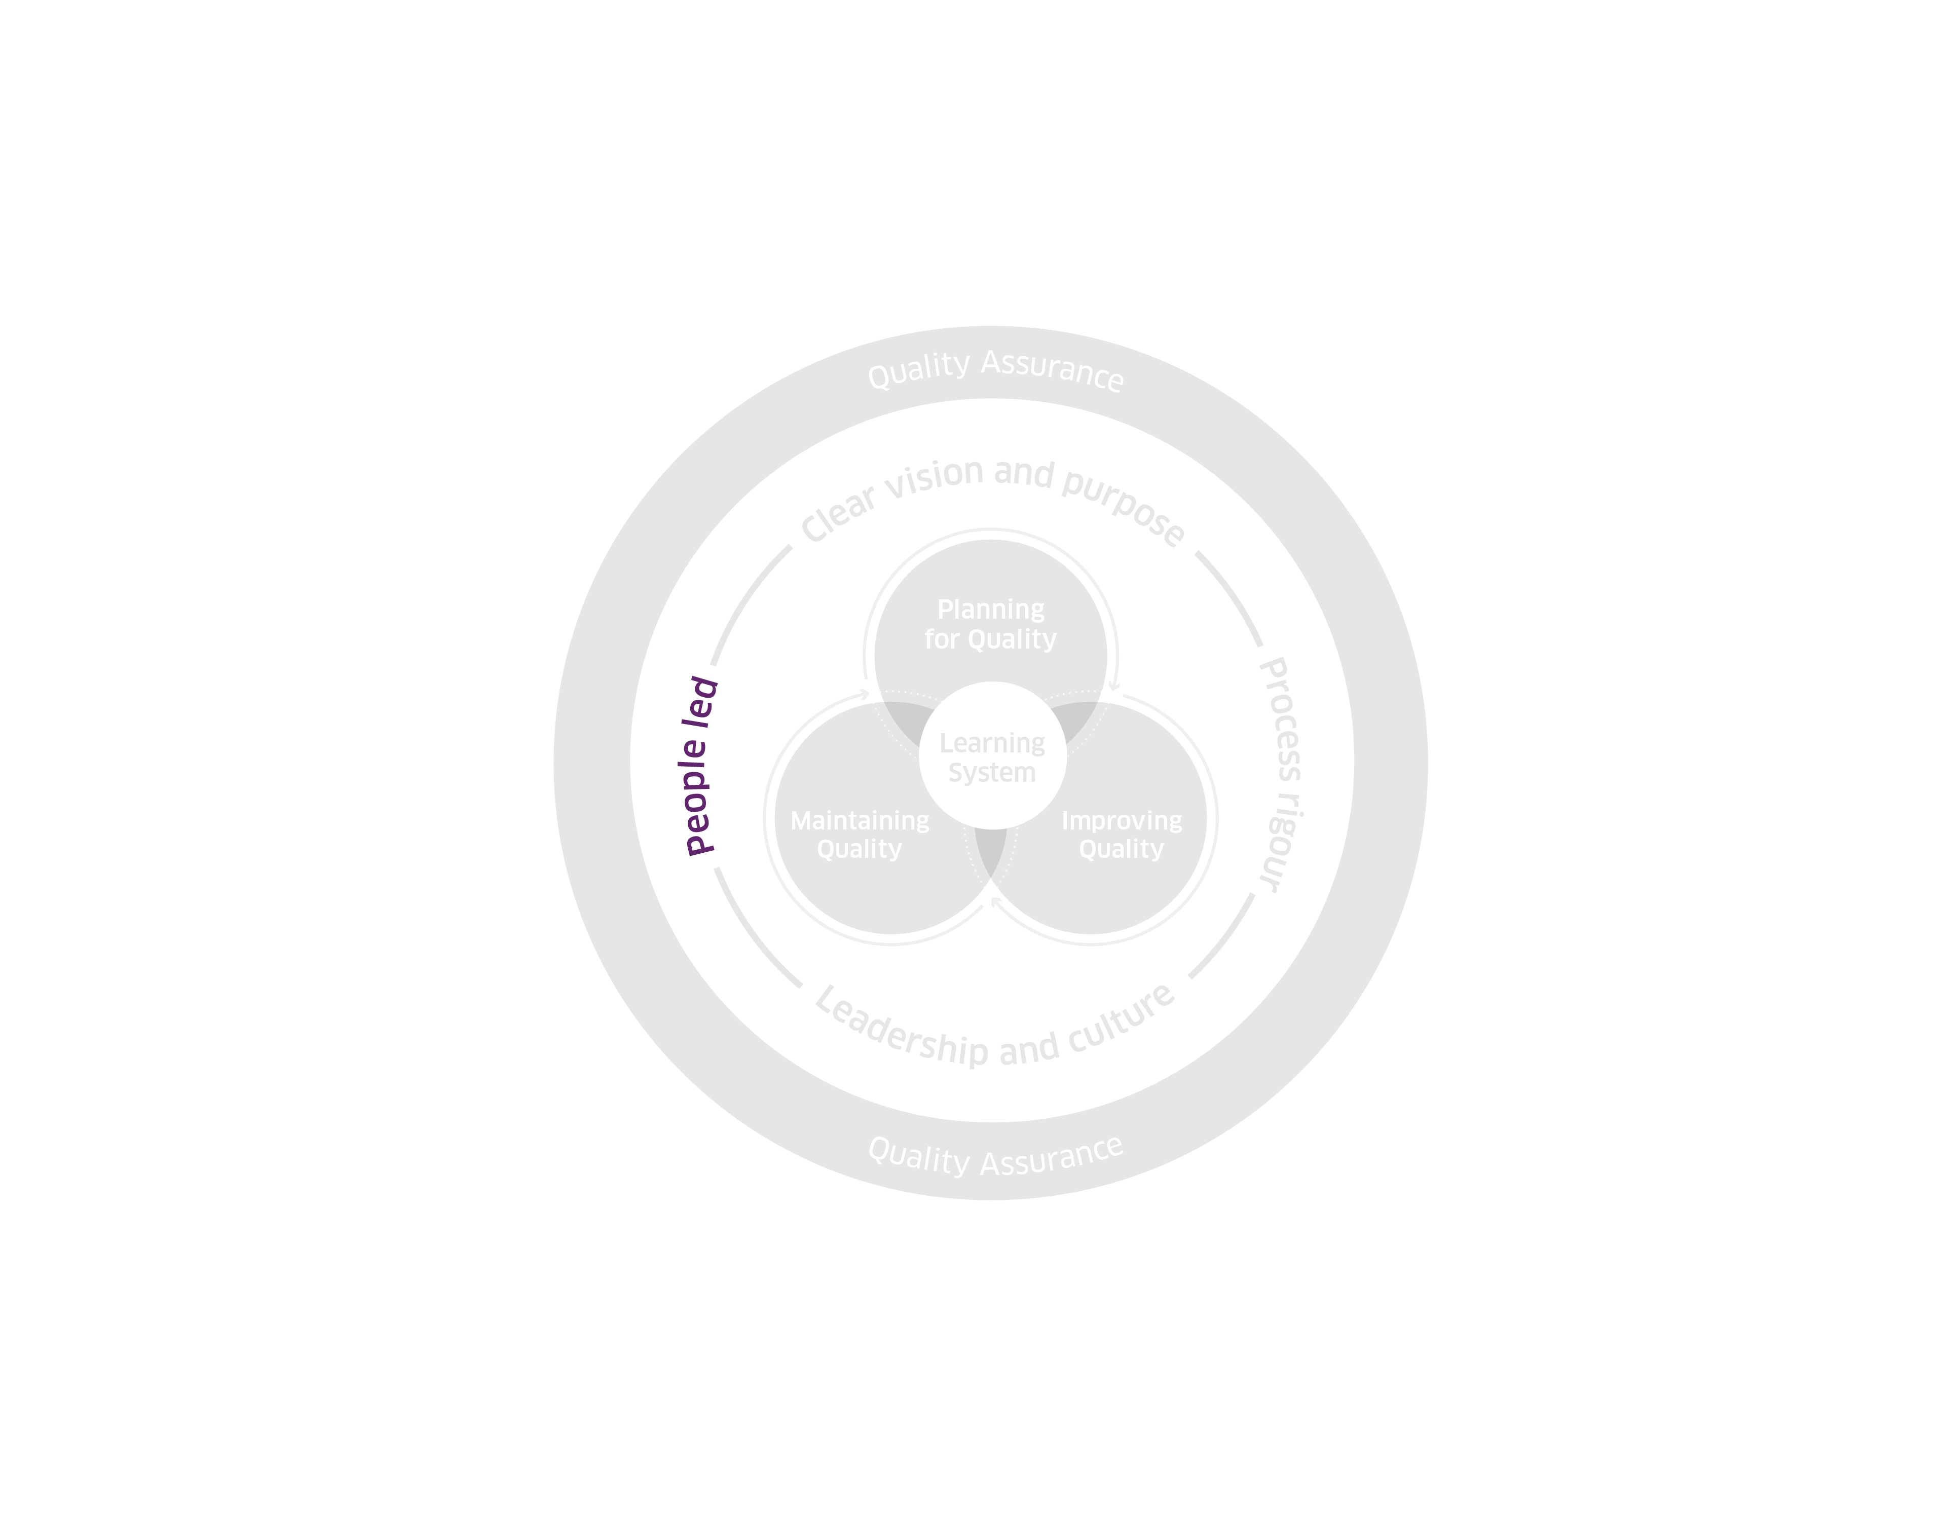
High-level Quality Management System
Framework 2025
© Healthcare Improvement Scotland. Published: 2025

Slide 82
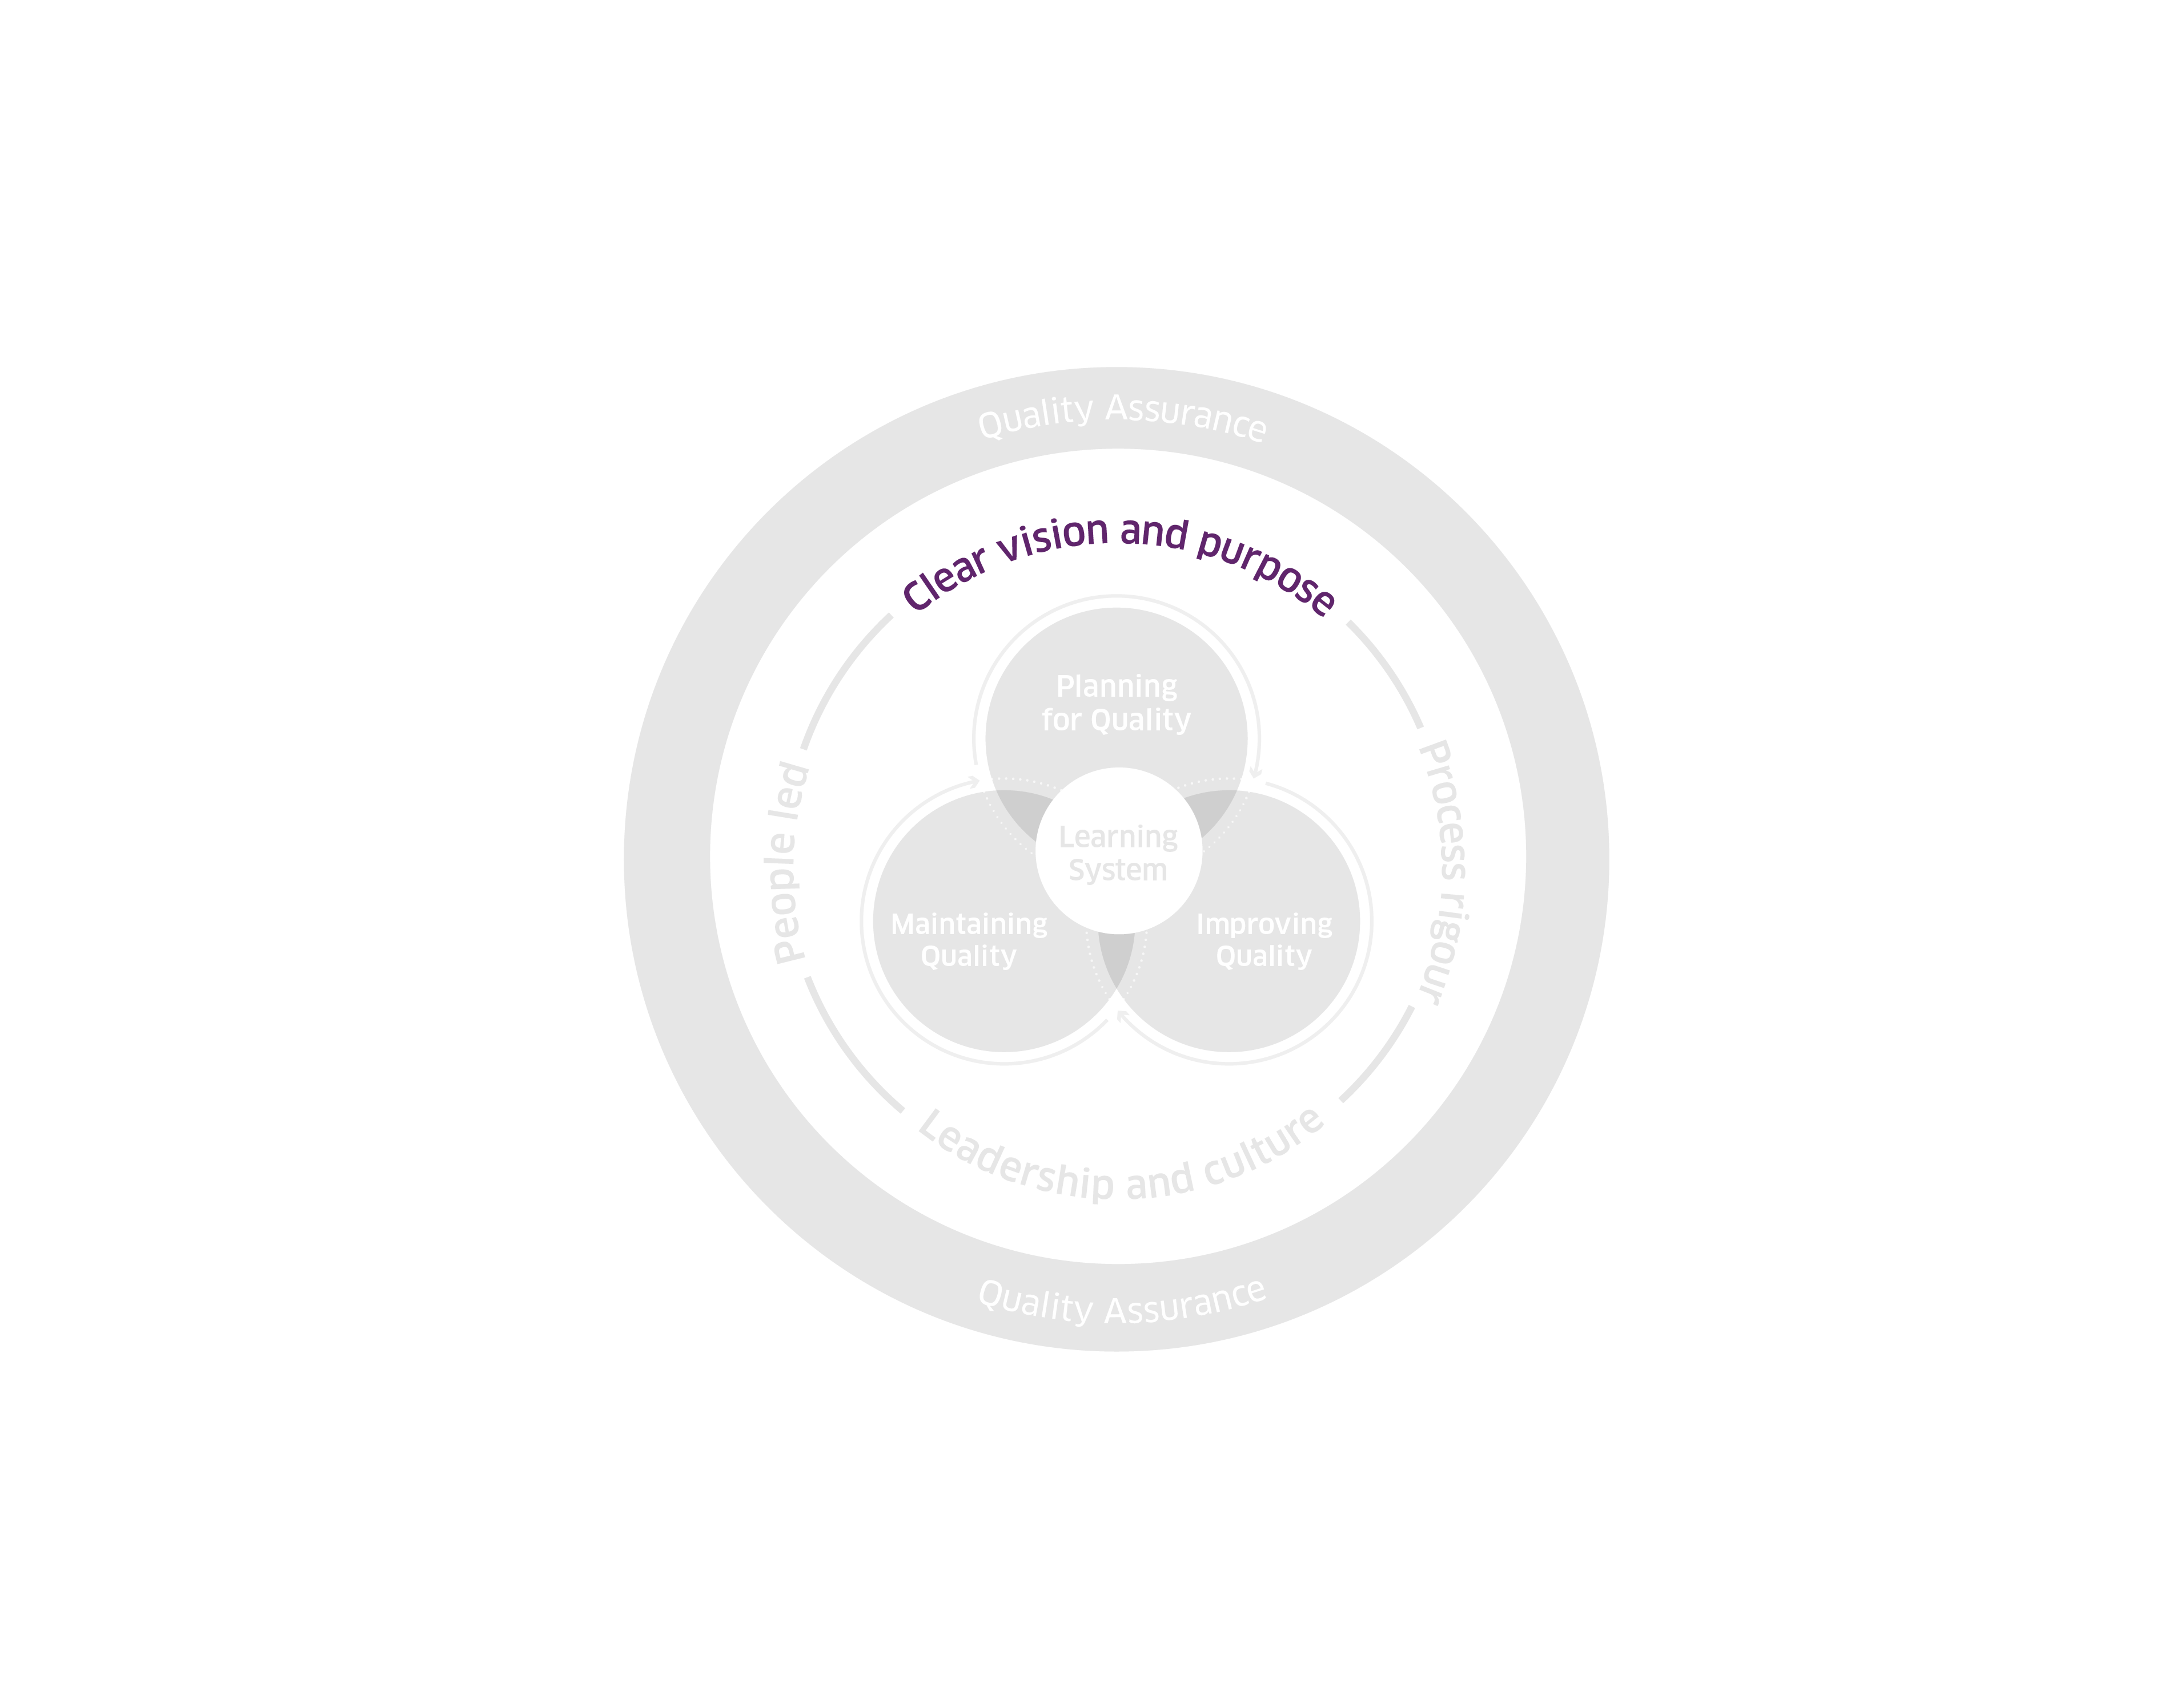
High-level Quality Management System
Framework 2025
© Healthcare Improvement Scotland. Published: 2025

Slide 83
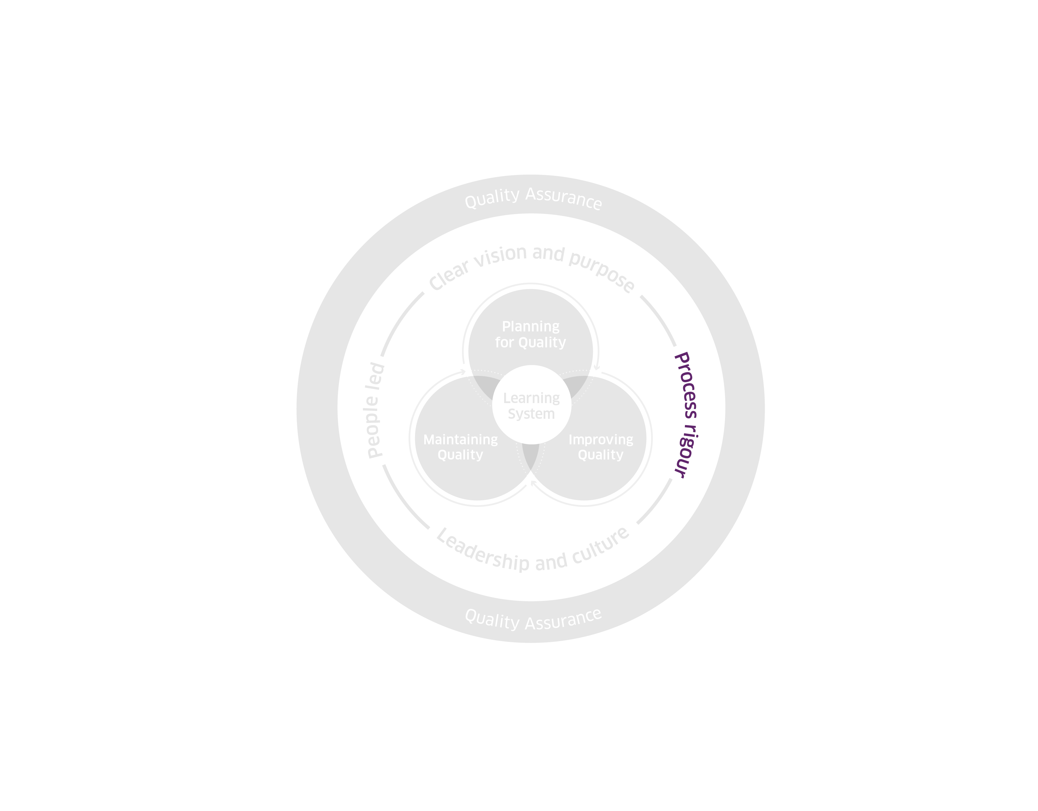
High-level Quality Management System
Framework 2025
© Healthcare Improvement Scotland. Published: 2025

Slide 84
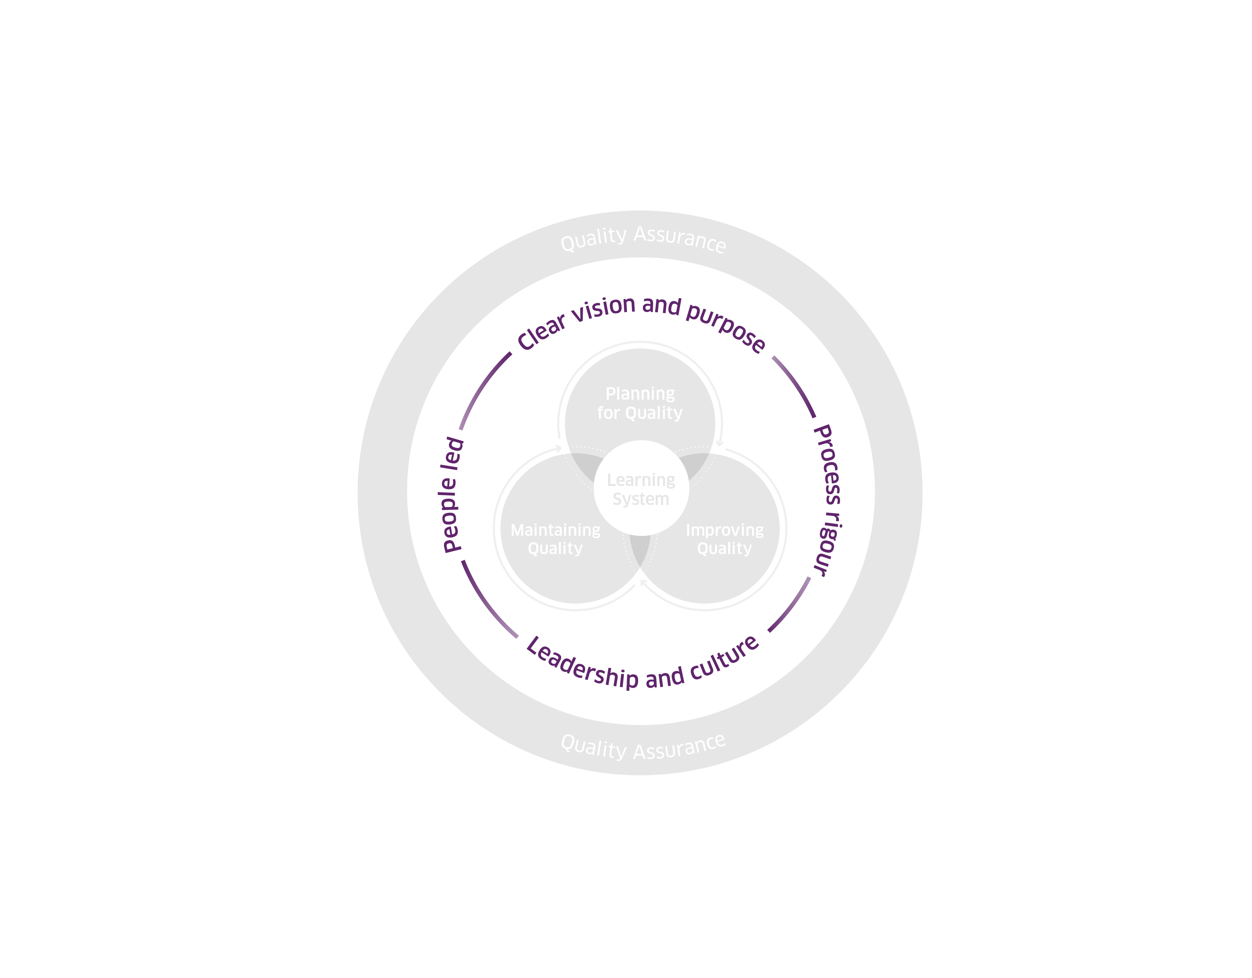
High-level Quality Management System
Framework 2025
© Healthcare Improvement Scotland. Published: 2025

Slide 85
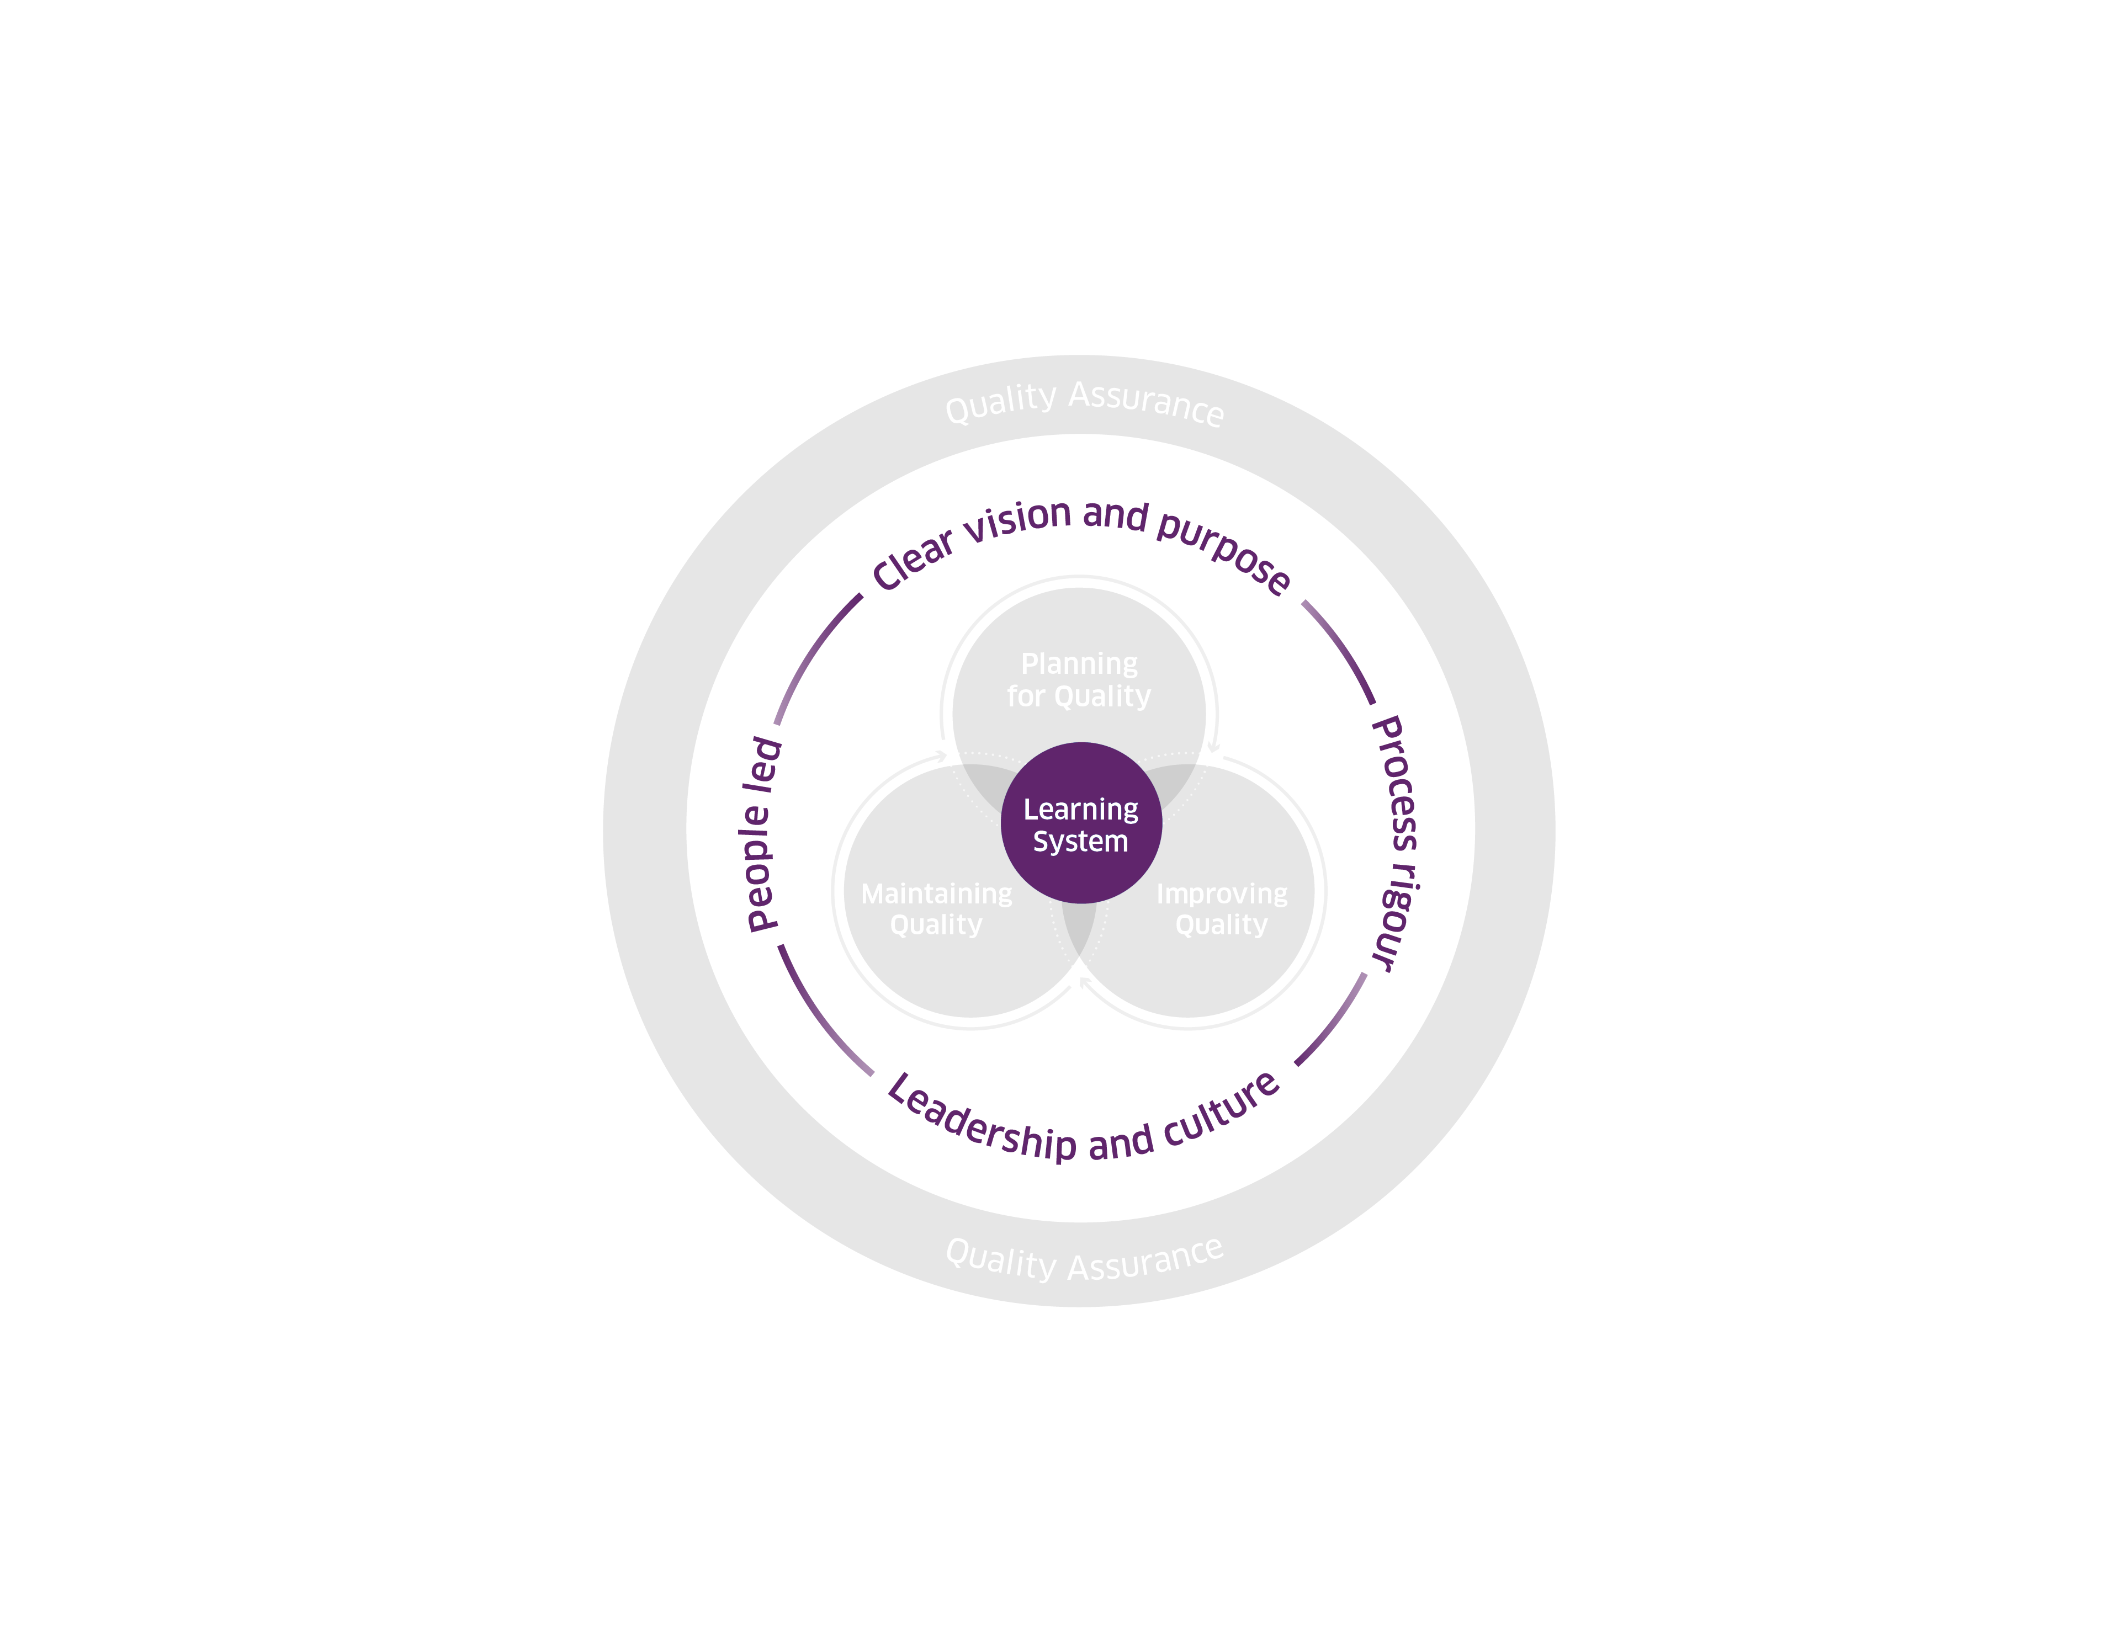
High-level Quality Management System
Framework 2025
© Healthcare Improvement Scotland. Published: 2025

Slide 86
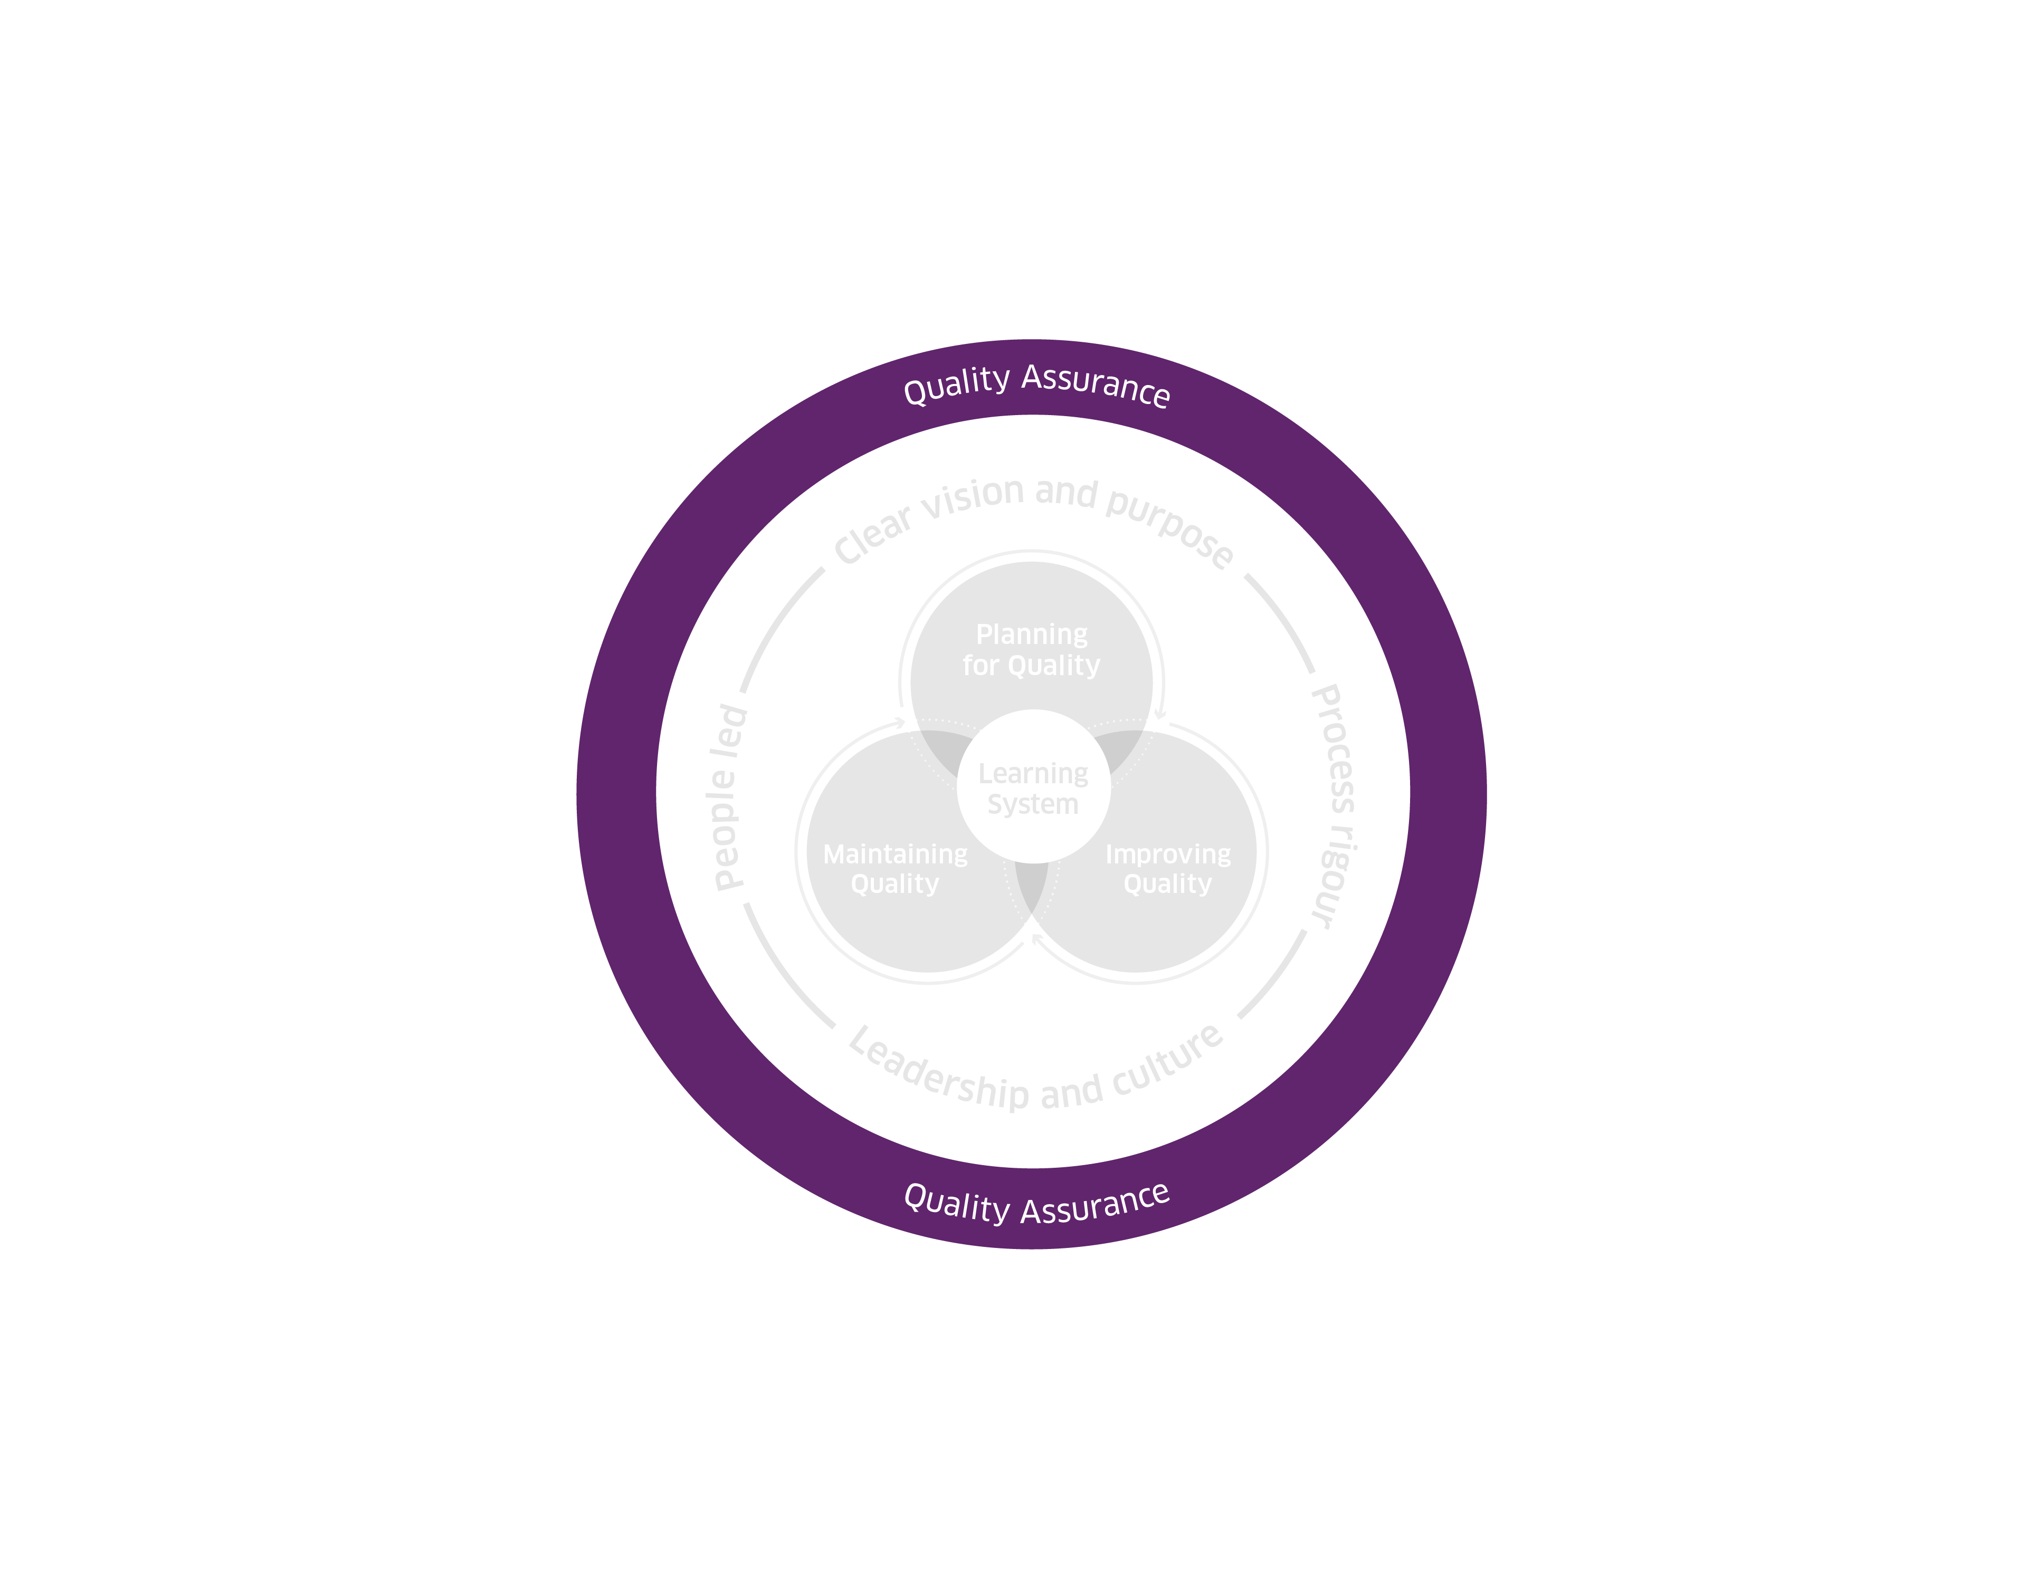
High-level Quality Management System
Framework 2025
© Healthcare Improvement Scotland. Published: 2025

Slide 87
High-level Quality Management System
Framework 2025
© Healthcare Improvement Scotland. Published: 2025

